Slide 1
Measles and Rubella
Global Update
April 2025

Slide 2
Distribution list
This report is posted on the WHO Immunization data portal (https://immunizationdata.who.int/global?topic=Provisional-measles-and-rubella-data&location=) and distributed by email on a monthly basis.
To join the distribution list, please send an email to Sebastien Antoni (antonis@who.int)

Slide 3
Disclaimer
Please note that all data contained within is provisional. The number of cases of measles and rubella officially reported by a member state is only available by July of each year (through the joint WHO UNICEF annual data collection exercise). If any numbers from this provisional data are quoted, they should be properly sourced with a date (i.e. "provisional data based on monthly data reported to WHO (Geneva) as of April 2025"). For official data from 1980-2023, please visit our website.

Slide 4
Data sources and limitations

Slide 5
Measles

Slide 6
Number of reported measles cases by WHO Region
2025
Region | Member States* | Suspected MR cases | Measles cases | Clin | Epi | Lab | Date Received
AFR | 37/47 | 19,678 | 10,623 | 2,882 | 3,238 | 4,503 | 2025-04
AMR | 24/35 | 3,339 | 1,267 | 0 | 185 | 1,082 | 2025-04
EMR | 19/21 | 19,062 | 12,867 | 6,210 | 382 | 6,275 | 2025-04
EUR | 43/53 | 9,747 | 6,841 | 1,592 | 2,048 | 3,201 | 2025-04
SEAR | 11/11 | 24,486 | 5,498 | 2,863 | 624 | 2,011 | 2025-04
WPR | 22/27 | 5,756 | 2,185 | 687 | 2 | 1,496 | 2025-04
Total | 156/194 | 82,068 | 39,281 | 14,234 | 6,479 | 18,568
Region | Jan | Feb | Mar | Apr | May | Jun | Jul | Aug | Sep | Oct | Nov | Dec
AFR | 4,400 | 4,528 | 1,695 | 0 | 0 | 0 | 0 | 0 | 0 | 0 | 0 | 0
AMR | 120 | 383 | 738 | 26 | 0 | 0 | 0 | 0 | 0 | 0 | 0 | 0
EMR | 6,522 | 4,367 | 1,974 | 4 | 0 | 0 | 0 | 0 | 0 | 0 | 0 | 0
EUR | 4,076 | 2,723 | 42 | 0 | 0 | 0 | 0 | 0 | 0 | 0 | 0 | 0
SEAR | 2,150 | 1,717 | 1,631 | 0 | 0 | 0 | 0 | 0 | 0 | 0 | 0 | 0
WPR | 1,247 | 938 | 0 | 0 | 0 | 0 | 0 | 0 | 0 | 0 | 0 | 0
Total | 18,515 | 14,656 | 6,080 | 30 | 0 | 0 | 0 | 0 | 0 | 0 | 0 | 0
2024
Region | Member States* | Suspected MR cases | Measles cases | Clin | Epi | Lab | Date Received
AFR | 43/47 | 153,308 | 86,127 | 15,884 | 51,811 | 18,432 | 2025-04
AMR | 33/35 | 18,893 | 462 | 0 | 53 | 409 | 2025-04
EMR | 20/21 | 161,413 | 96,618 | 52,179 | 6,207 | 38,232 | 2025-04
EUR | 52/53 | 149,027 | 127,406 | 21,831 | 20,130 | 85,445 | 2025-04
SEAR | 11/11 | 157,033 | 36,881 | 12,296 | 6,952 | 17,633 | 2025-04
WPR | 25/27 | 67,239 | 11,972 | 3,853 | 652 | 7,467 | 2025-04
Total | 184/194 | 706,913 | 359,466 | 106,043 | 85,805 | 167,618
Region | Jan | Feb | Mar | Apr | May | Jun | Jul | Aug | Sep | Oct | Nov | Dec
AFR | 13,630 | 15,801 | 19,233 | 11,624 | 7,782 | 4,419 | 2,969 | 2,331 | 2,501 | 2,270 | 2,207 | 1,360
AMR | 23 | 49 | 103 | 47 | 18 | 19 | 41 | 38 | 37 | 33 | 44 | 10
EMR | 13,496 | 15,461 | 15,725 | 10,904 | 10,910 | 7,071 | 5,074 | 3,558 | 3,838 | 3,690 | 3,269 | 3,622
EUR | 29,072 | 24,210 | 20,536 | 15,698 | 12,923 | 9,449 | 5,179 | 2,413 | 1,501 | 1,391 | 2,019 | 3,015
SEAR | 3,899 | 3,793 | 4,731 | 3,451 | 2,873 | 1,915 | 2,040 | 2,811 | 3,182 | 3,671 | 2,710 | 1,805
WPR | 1,015 | 1,040 | 1,236 | 1,163 | 994 | 634 | 739 | 755 | 764 | 960 | 1,339 | 1,333
Total | 61,135 | 60,354 | 61,564 | 42,887 | 35,500 | 23,507 | 16,042 | 11,906 | 11,823 | 12,015 | 11,588 | 11,145
Notes: Based on data received 2025-04 - This is surveillance data, hence for the last month, the data may be incomplete. * Member States Reporting / Total Member States in Region

Slide 7

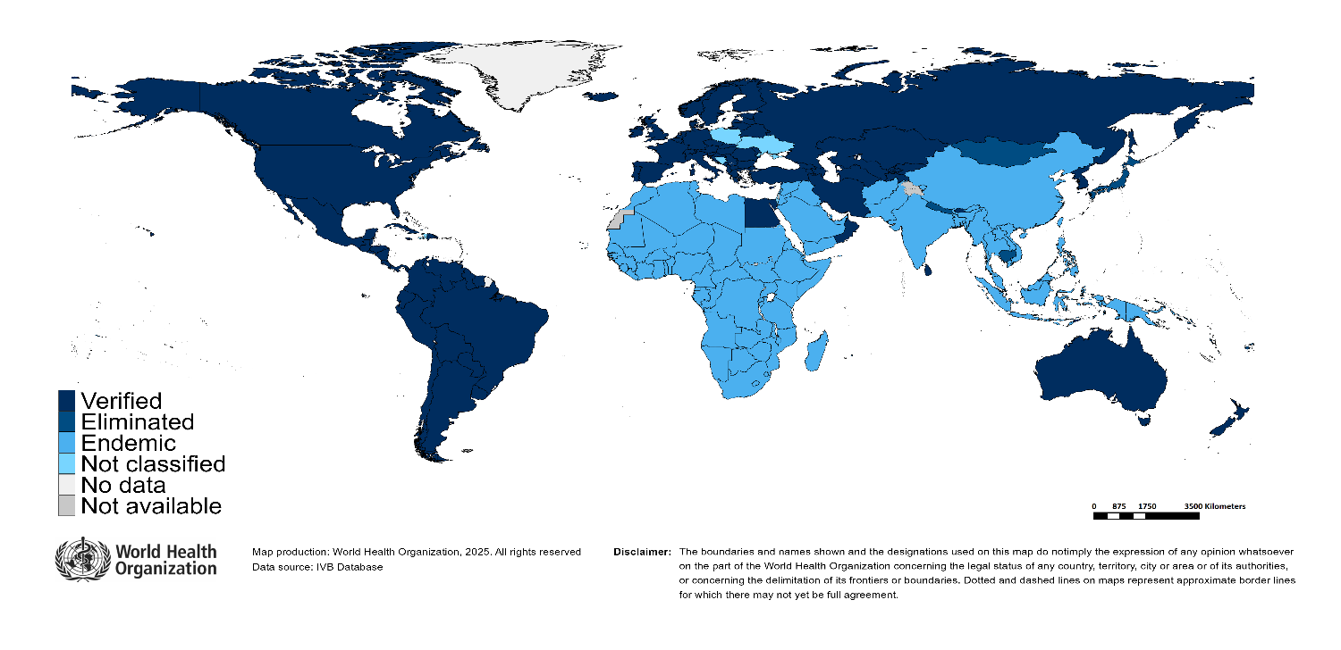
Measles/rubella verification of elimination
Measles
Region | Member States | Verified | % Verified | Eliminated | Endemic | Not classified
AFR | 47 | 0 | 0 | 0 | 47 | 0
AMR | 35 | 34 | 97 | 0 | 0 | 1
EMR | 21 | 4 | 19 | 0 | 17 | 0
EUR | 53 | 33 | 62 | 8 | 11 | 1
SEAR | 11 | 4 | 36 | 0 | 7 | 0
WPR | 27 | 6 | 22 | 15 | 6 | 0
GLOBAL | 194 | 81 | 42 | 23 | 88 | 2
Rubella
Region | Member States | Verified | % Verified | Eliminated | Endemic | Not classified
AFR | 47 | 0 | 0 | 0 | 47 | 0
AMR | 35 | 34 | 97 | 0 | 0 | 1
EMR | 21 | 4 | 19 | 0 | 17 | 0
EUR | 53 | 49 | 92 | 0 | 0 | 4
SEAR | 11 | 5 | 45 | 1 | 5 | 0
WPR | 27 | 5 | 19 | 16 | 6 | 0
GLOBAL | 194 | 97 | 50 | 17 | 75 | 5
Notes: Based on data available at WHO HQ as of 2025-04-10 . Terms used on this slide refer to the global framework for the verification of measles and rubella elimination. These terms might differ from those used by WHO Regional Offices. Verified = Elimination verified by Regional Verification Commitee (RVC); Eliminated = Eliminated transmission but no RVC verification yet.

Slide 8
Measles case distribution by month and WHO Region (2020-2025)
2020
2021
2022
2023
2024
2025
93,840 cases
59,619 cases
174,340 cases
321,877 cases
359,466 cases
39,281 cases
60,000
AFR
40,000
AMR
EMR
EUR
SEAR
WPR
20,000
0
Jan
Feb
Mar
Apr
May
Jun
Jul
Aug
Sep
Oct
Nov
Dec
Jan
Feb
Mar
Apr
May
Jun
Jul
Aug
Sep
Oct
Nov
Dec
Jan
Feb
Mar
Apr
May
Jun
Jul
Aug
Sep
Oct
Nov
Dec
Jan
Feb
Mar
Apr
May
Jun
Jul
Aug
Sep
Oct
Nov
Dec
Jan
Feb
Mar
Apr
May
Jun
Jul
Aug
Sep
Oct
Nov
Dec
Jan
Feb
Mar
Apr
May
Jun
Jul
Aug
Sep
Oct
Nov
Dec
Based on data received 2025-04 - Data Source: IVB Database - This is surveillance data, hence for the last month(s), the data may be incomplete.

Slide 9
Measles case distribution by month and WHO Region (2017-2025)
2017
2018
2019
2020
2021
2022
2023
2024
2025
168,190 cases
276,157 cases
541,401 cases
93,840 cases
59,619 cases
174,340 cases
321,877 cases
359,466 cases
39,281 cases
125,000
100,000
AFR
75,000
AMR
EMR
EUR
SEAR
50,000
WPR
25,000
0
May
Aug
Sep
May
Aug
Sep
May
Aug
Sep
May
Aug
Sep
May
Aug
Sep
May
Aug
Sep
May
Aug
Sep
May
Aug
Sep
May
Aug
Sep
Jan
Feb
Apr
Jun
Jul
Oct
Jan
Apr
Jun
Jul
Oct
Jan
Apr
Jun
Jul
Oct
Jan
Apr
Jun
Jul
Oct
Jan
Apr
Jun
Jul
Oct
Jan
Apr
Jun
Jul
Oct
Jan
Apr
Jun
Jul
Oct
Jan
Apr
Jun
Jul
Oct
Jan
Apr
Jun
Jul
Oct
Mar
Nov
Dec
Feb
Mar
Nov
Dec
Feb
Mar
Nov
Dec
Feb
Mar
Nov
Dec
Feb
Mar
Nov
Dec
Feb
Mar
Nov
Dec
Feb
Mar
Nov
Dec
Feb
Mar
Nov
Dec
Feb
Mar
Nov
Dec
Based on data received 2025-04 - Data Source: IVB Database - This is surveillance data, hence for the last month(s), the data may be incomplete.

Slide 10
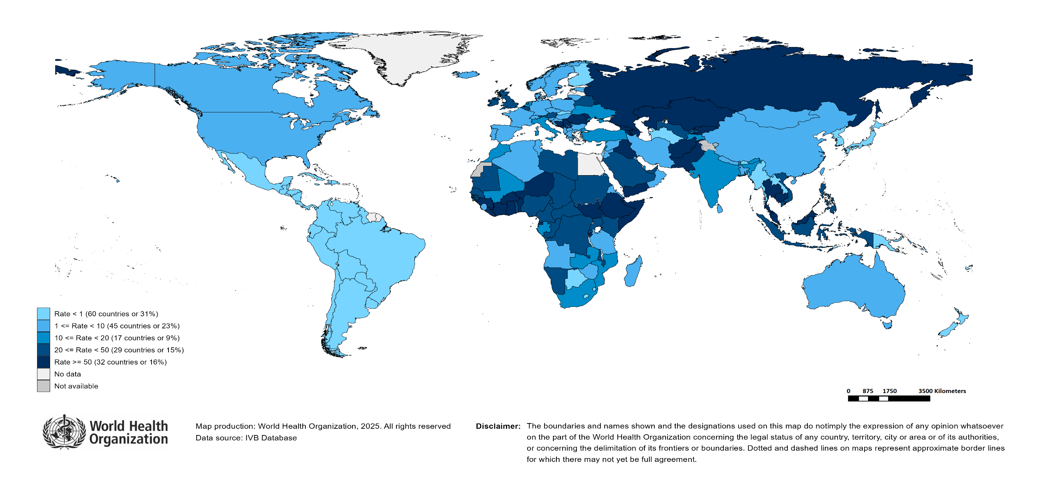
Measles Incidence Rate per Million (12M period)
Highest incidence rates | Highest incidence rates | Highest incidence rates
Country | Cases | Rate
Kyrgyzstan | 12030 | 1,674.09
Romania | 23980 | 1,261.10
Kazakhstan | 11930 | 579.34
Yemen | 22737 | 560.26
Bosnia and Herzegovina | 1300 | 410.84
Iraq | 17139 | 372.25
Azerbaijan | 3612 | 349.44
Liberia | 1572 | 280.07
Afghanistan | 11033 | 258.70
Burkina Faso | 5162 | 219.20
Notes: Based on data received 2025-04 - Surveillance data from 2024-03 to 2025-02 - Incidence: Number of cases / population * 1,000,000 - Population data: World population prospects, 2019 revision

Slide 11
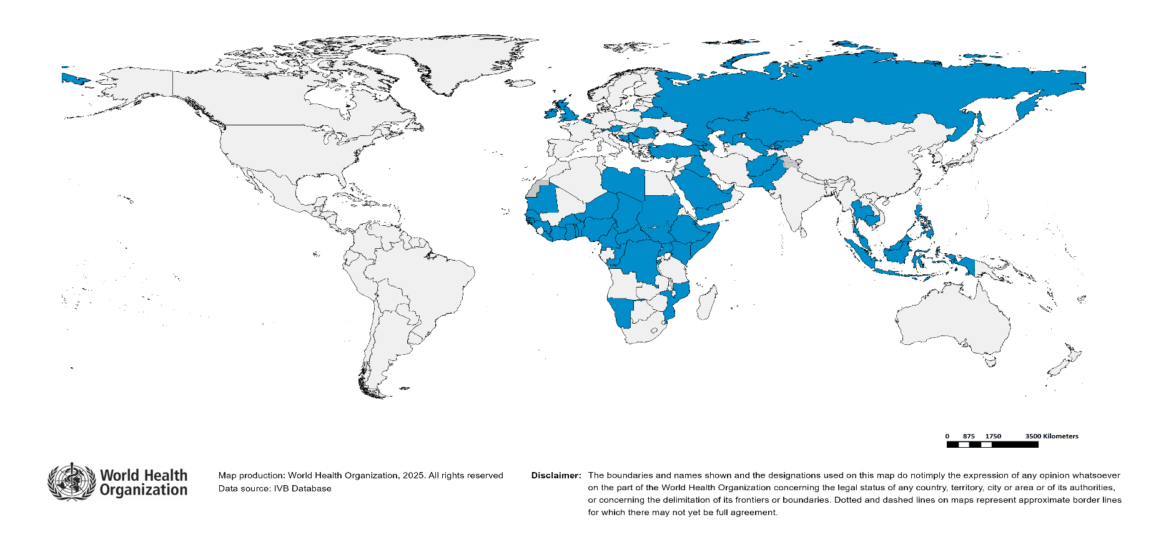
Immunization Agenda 2030 - Impact Goal 1.3
Countries provisionally meeting the large and disruptive outbreaks definition - Data from 2023-12 to 2024-11 included
Country | Cases | Rate/M | Clinical*
Azerbaijan | 28,024 | 2,711.15 | 63%
Kyrgyzstan | 14,997 | 2,086.97 | 44%
Romania | 30,690 | 1,613.98 | 3%
Kazakhstan | 29,500 | 1,432.56 | 2%
Iraq | 35,161 | 763.67 | 86%
Yemen | 24,679 | 608.11 | 93%
Bosnia and Herzegovina | 1,678 | 530.30 | 80%
Liberia | 2,245 | 399.98 | 11%
Burkina Faso | 7,453 | 316.49 | 70%
Equatorial Guinea | 524 | 276.88 | 58%
South Sudan | 3,076 | 257.55 | 68%
Ethiopia | 29,690 | 224.82 | 0%
Burundi | 3,056 | 217.54 | 1%
Afghanistan | 9,139 | 214.29 | 0%
Côte d'Ivoire | 6,774 | 212.12 | 0%
Armenia | 588 | 197.72 | 0%
Russian Federation | 23,546 | 162.59 | 1%
Ghana | 4,235 | 123.01 | 1%
Malaysia | 3,981 | 111.96 | 7%
Thailand | 7,781 | 108.57 | 34%
Serbia | 725 | 107.63 | 25%
Pakistan | 24,673 | 98.19 | 8%
Georgia | 324 | 85.09 | 7%
Somalia | 1,522 | 80.07 | 0%
Mauritania | 385 | 74.48 | 0%
Republic of Moldova | 215 | 70.84 | 1%
Belarus | 607 | 67.02 | 1%
Chad | 1,228 | 60.50 | 7%
San Marino | 2 | 59.56 | 0%
Niger | 1,561 | 57.75 | 28%
Country | Cases | Rate/M | Clinical*
Austria | 522 | 57.23 | 0%
United Arab Emirates | 610 | 55.32 | 8%
Monaco | 2 | 51.77 | 0%
Montenegro | 33 | 51.69 | 0%
Djibouti | 60 | 51.34 | 0%
Benin | 737 | 50.96 | 19%
Nigeria | 10,984 | 47.21 | 52%
DR Congo | 5,070 | 46.40 | 2%
Belgium | 531 | 45.23 | 6%
Uzbekistan | 1,579 | 43.42 | 2%
Guinea | 615 | 41.68 | 8%
United Kingdom of Great Britain and Northern Ireland | 2,860 | 41.37 | 0%
Togo | 392 | 41.20 | 12%
Saudi Arabia | 1,254 | 36.92 | 0%
Philippines | 4,132 | 35.67 | 82%
Ireland | 187 | 35.59 | 1%
Senegal | 563 | 30.43 | 7%
Cameroon | 856 | 29.39 | 11%
Congo | 182 | 28.74 | 7%
Indonesia | 7,347 | 25.92 | 58%
Kenya | 1,414 | 25.06 | 5%
Libya | 180 | 24.39 | 0%
Sudan | 1,190 | 23.59 | 6%
Namibia | 70 | 23.10 | 67%
Central African Republic | 117 | 21.95 | 4%
Guinea-Bissau | 48 | 21.80 | 100%
Mozambique | 733 | 21.17 | 37%
Cambodia | 358 | 20.30 | 0%
Türkiye | 1,763 | 20.15 | 0%
Uganda | 1,004 | 20.07 | 4%
Total: 60 countries
In the frame of tracking progress towards the goals of Immunization Agenda 2030 (IA2030), an indicator has been developed by a working group in order to represent large and disruptive measles outbreaks. This indicator is defined as an incidence equal or greater than 20 reported measles cases per million population over a period of 12 months. It is important to note that measles outbreak definitions vary between countries and regions according to local context and level of progress towards regional elimination goals. This definition of large and disruptive outbreaks aims to complement and not replace the national and regional definitions, while also providing a degree of global standardization and permitting tracking of progress against a common metric.
Notes: Based on data received 2025-04 and covering the period between 2023-12 and 2024-11 - Incidence: Number of cases / 1M population - Population Data: World population prospects, 2019 revision - A high proportion of clinical cases indicates a high level of uncertainty associated with the incidence rates and the inclusion of countries in this list.

Slide 12
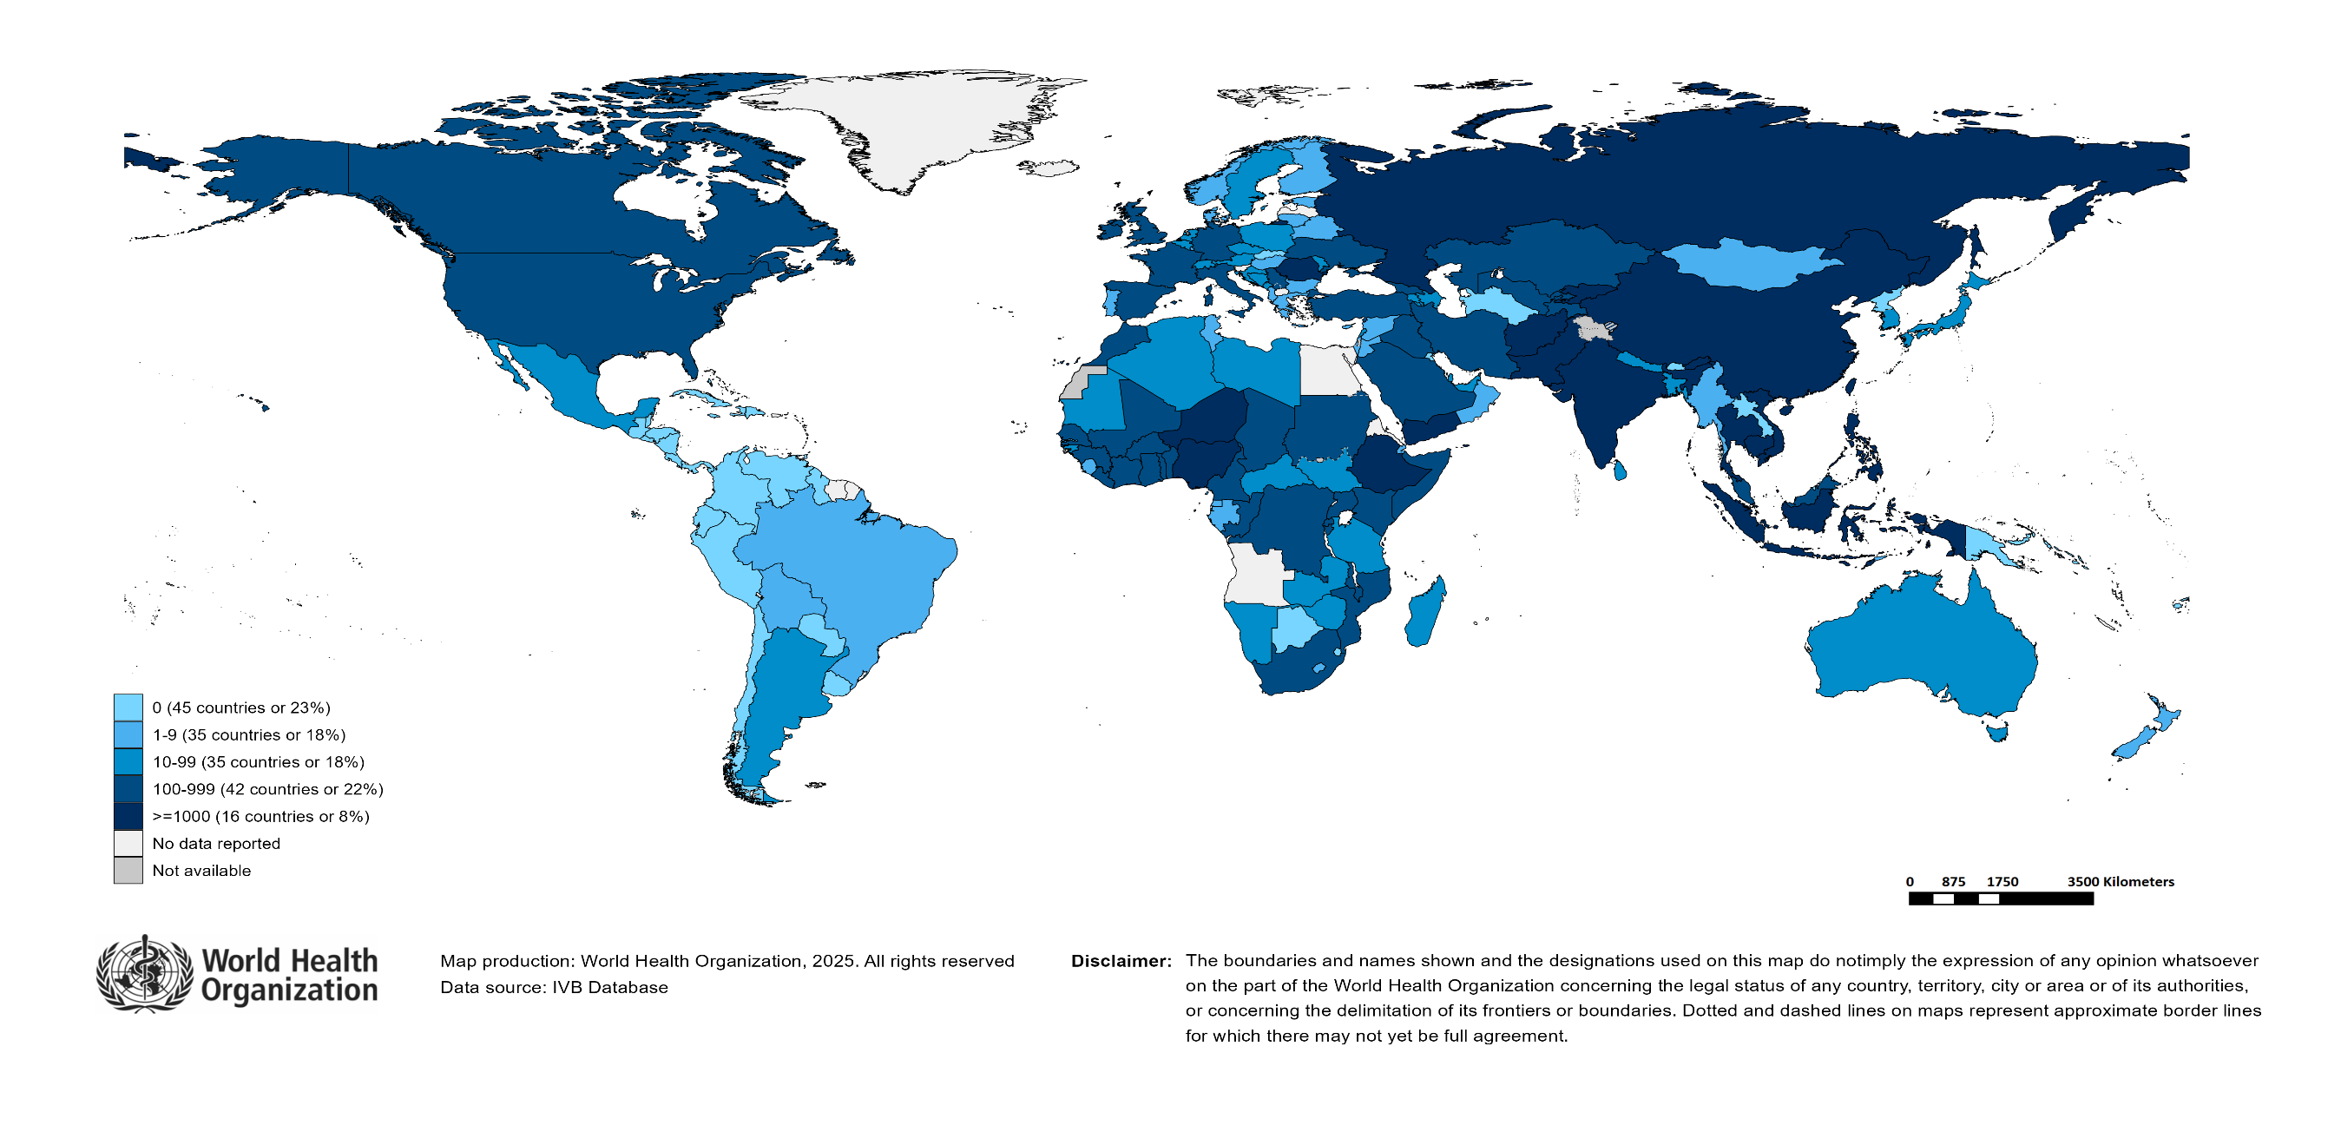
Number of Reported Measles Cases (Last 6 months)
Country | Cases*
Yemen | 10,794
India** | 7,201
Pakistan | 6,217
Ethiopia | 5,309
Afghanistan | 5,236
Thailand | 5,142
Kyrgyzstan | 4,502
Romania | 4,077
Indonesia | 2,751
Nigeria | 1,892
Notes: Based on data received 2025-04 - Surveillance data from 2024-09 to 2025-02 - * Countries with highest number of cases for the period - **WHO classifies all suspected measles cases reported from India as measles clinically compatible if a specimen was not collected as per the algorithm for classification of suspected measles in the WHO VPD Surveillance Standards. Thus numbers might be different between what WHO reports and what India reports.

Slide 13

Surveillance sensitivity reporting rate of measles and rubella (12 months, discarded cases* per 100,000 population)
Notes: Based on data received 2025-04 - Surveillance data from 2024-03 to 2025-02 - Target: >= 2 discarded cases* / 100,000 population** - * Suspected cases investigated and discarded as non-measles non-rubella using laboratory testing and/or epidemiological linkage to another etiology ** World population prospects, 2019 revision

Slide 14
Disclaimer
This document contains data provided to WHO by member states. Note that some member states only provide aggregate data to WHO, and for these, we are unable to generate a country profile. Some member states report all cases at one time point for the entire year, and thus epidemiologic curves generated are not accurate and a reporting artifact. For some countries, cases are reported by age category, not by exact age in months and/or years. Thus, age distribution/incidence is approximate. Cases classified as pending by countries are classified at WHO as clinically compatible at this time, and thus numbers might different between data shown here and provided by the member state or WHO country/regional offices.
*UN population data is used as the denominator for calculating incidence.

Slide 15
Measles case distribution (AFR), 2020-2025
2020
2021
2022
2023
2024
2025
20,000
46,747 cases
26,492 cases
64,922 cases
73,443 cases
86,127 cases
10,623 cases
15,000
10,000
5,000
0
Jan
Feb
Mar
Apr
May
Jun
Jul
Aug
Sep
Oct
Nov
Dec
Jan
Feb
Mar
Apr
May
Jun
Jul
Aug
Sep
Oct
Nov
Dec
Jan
Feb
Mar
Apr
May
Jun
Jul
Aug
Sep
Oct
Nov
Dec
Jan
Feb
Mar
Apr
May
Jun
Jul
Aug
Sep
Oct
Nov
Dec
Jan
Feb
Mar
Apr
May
Jun
Jul
Aug
Sep
Oct
Nov
Dec
Jan
Feb
Mar
Apr
May
Jun
Jul
Aug
Sep
Oct
Nov
Dec
Cameroon
DR Congo
Ethiopia
Liberia
Nigeria
Others
Based on data received 2025-04 - Data Source: IVB Database

Slide 16
Measles cases: Benin
ELIMINATION STATUS:
ENDEMIC
2021
2022
2023
2024
2025
27 cases
437 cases
482 cases
779 cases
440 cases
300
200
Number of measles cases
100
0
Jan
Feb
Mar
Apr
May
Jun
Jul
Aug
Sep
Oct
Nov
Dec
Jan
Feb
Mar
Apr
May
Jun
Jul
Aug
Sep
Oct
Nov
Dec
Jan
Feb
Mar
Apr
May
Jun
Jul
Aug
Sep
Oct
Nov
Dec
Jan
Feb
Mar
Apr
May
Jun
Jul
Aug
Sep
Oct
Nov
Dec
Jan
Feb
Mar
Apr
May
Jun
Jul
Aug
Sep
Oct
Nov
Dec
SIA
Discarded
Clinical
Epi
Lab
Age distribution, vaccination status and incidence (last 12 months)
WHO/UNICEF Coverage Estimates (WUENIC)
500
100
400
300
80
300
200
60
Number of cases
Incidence rate per M
200
% Coverage
100
100
40
0
0
20
<1 yr
1-4 yrs
5-9 yrs
10-14 yrs
15-24 yrs
25-39 yrs
40+ yrs
0
Age at onset (in years)
2000
2001
2002
2003
2004
2005
2006
2007
2008
2009
2010
2011
2012
2013
2014
2015
2016
2017
2018
2019
2020
2021
2022
2023
Incidence
2+ doses
1 dose
0 doses
Unknown
MCV1
MCV2
Based on data received 2025-04 - Data Source: IVB Database. Main epi curve was built using case-based surveillance data. Age distribution curve was built using case-based surveillance data. Coverage data from WHO/UNICEF Estimates of National Immunization Coverage (WUENIC)

Slide 17
Measles cases: Burkina Faso
ELIMINATION STATUS:
ENDEMIC
2021
2022
2023
2024
2025
3,000
456 cases
1,019 cases
1,578 cases
7,290 cases
665 cases
2,000
Number of measles cases
1,000
0
Jan
Feb
Mar
Apr
May
Jun
Jul
Aug
Sep
Oct
Nov
Dec
Jan
Feb
Mar
Apr
May
Jun
Jul
Aug
Sep
Oct
Nov
Dec
Jan
Feb
Mar
Apr
May
Jun
Jul
Aug
Sep
Oct
Nov
Dec
Jan
Feb
Mar
Apr
May
Jun
Jul
Aug
Sep
Oct
Nov
Dec
Jan
Feb
Mar
Apr
May
Jun
Jul
Aug
Sep
Oct
Nov
Dec
SIA
Discarded
Clinical
Epi
Lab
Age distribution, vaccination status and incidence (last 12 months)
WHO/UNICEF Coverage Estimates (WUENIC)
800
100
400
600
80
Number of cases
Incidence rate per M
60
200
400
% Coverage
200
40
0
0
20
<1 yr
1-4 yrs
5-9 yrs
10-14 yrs
15-24 yrs
25-39 yrs
40+ yrs
0
Age at onset (in years)
2000
2001
2002
2003
2004
2005
2006
2007
2008
2009
2010
2011
2012
2013
2014
2015
2016
2017
2018
2019
2020
2021
2022
2023
Incidence
2+ doses
1 dose
0 doses
Unknown
MCV1
MCV2
Based on data received 2025-04 - Data Source: IVB Database. Main epi curve was built using case-based surveillance data. Age distribution curve was built using case-based surveillance data. Coverage data from WHO/UNICEF Estimates of National Immunization Coverage (WUENIC)

Slide 18
Measles cases: Democratic Republic of the Congo
ELIMINATION STATUS:
ENDEMIC
2021
2022
2023
2024
2025
3,000
3,443 cases
4,365 cases
10,701 cases
5,086 cases
352 cases
2,000
Number of measles cases
1,000
0
Jan
Feb
Mar
Apr
May
Jun
Jul
Aug
Sep
Oct
Nov
Dec
Jan
Feb
Mar
Apr
May
Jun
Jul
Aug
Sep
Oct
Nov
Dec
Jan
Feb
Mar
Apr
May
Jun
Jul
Aug
Sep
Oct
Nov
Dec
Jan
Feb
Mar
Apr
May
Jun
Jul
Aug
Sep
Oct
Nov
Dec
Jan
Feb
Mar
Apr
May
Jun
Jul
Aug
Sep
Oct
Nov
Dec
SIA
Discarded
Clinical
Epi
Lab
Age distribution, vaccination status and incidence (last 12 months)
WHO/UNICEF Coverage Estimates (WUENIC)
2,500
100
2,000
150
80
1,500
100
60
Number of cases
1,000
Incidence rate per M
% Coverage
500
50
40
0
0
20
<1 yr
1-4 yrs
5-9 yrs
10-14 yrs
15-24 yrs
25-39 yrs
40+ yrs
0
Age at onset (in years)
2000
2001
2002
2003
2004
2005
2006
2007
2008
2009
2010
2011
2012
2013
2014
2015
2016
2017
2018
2019
2020
2021
2022
2023
Incidence
2+ doses
1 dose
0 doses
Unknown
MCV1
MCV2
Based on data received 2025-04 - Data Source: IVB Database. Main epi curve was built using case-based surveillance data. Age distribution curve was built using case-based surveillance data. Coverage data from WHO/UNICEF Estimates of National Immunization Coverage (WUENIC)

Slide 19
Measles cases: Ethiopia
ELIMINATION STATUS:
ENDEMIC
10,000
2021
2022
2023
2024
2025
1,947 cases
8,216 cases
16,505 cases
30,201 cases
2,579 cases
7,500
5,000
Number of measles cases
2,500
0
Jan
Feb
Mar
Apr
May
Jun
Jul
Aug
Sep
Oct
Nov
Dec
Jan
Feb
Mar
Apr
May
Jun
Jul
Aug
Sep
Oct
Nov
Dec
Jan
Feb
Mar
Apr
May
Jun
Jul
Aug
Sep
Oct
Nov
Dec
Jan
Feb
Mar
Apr
May
Jun
Jul
Aug
Sep
Oct
Nov
Dec
Jan
Feb
Mar
Apr
May
Jun
Jul
Aug
Sep
Oct
Nov
Dec
SIA
Discarded
Clinical
Epi
Lab
Age distribution, vaccination status and incidence (last 12 months)
WHO/UNICEF Coverage Estimates (WUENIC)
8,000
600
100
6,000
400
80
Number of cases
4,000
Incidence rate per M
60
200
% Coverage
2,000
40
0
0
20
<1 yr
1-4 yrs
5-9 yrs
10-14 yrs
15-24 yrs
25-39 yrs
40+ yrs
0
Age at onset (in years)
2000
2001
2002
2003
2004
2005
2006
2007
2008
2009
2010
2011
2012
2013
2014
2015
2016
2017
2018
2019
2020
2021
2022
2023
Incidence
2+ doses
1 dose
0 doses
Unknown
MCV1
MCV2
Based on data received 2025-04 - Data Source: IVB Database. Main epi curve was built using case-based surveillance data. Age distribution curve was built using case-based surveillance data. Coverage data from WHO/UNICEF Estimates of National Immunization Coverage (WUENIC)

Slide 20
Measles cases: Guinea
ELIMINATION STATUS:
ENDEMIC
2021
2022
2023
2024
2025
400
474 cases
429 cases
204 cases
635 cases
368 cases
300
Number of measles cases
200
100
0
Jan
Feb
Mar
Apr
May
Jun
Jul
Aug
Sep
Oct
Nov
Dec
Jan
Feb
Mar
Apr
May
Jun
Jul
Aug
Sep
Oct
Nov
Dec
Jan
Feb
Mar
Apr
May
Jun
Jul
Aug
Sep
Oct
Nov
Dec
Jan
Feb
Mar
Apr
May
Jun
Jul
Aug
Sep
Oct
Nov
Dec
Jan
Feb
Mar
Apr
May
Jun
Jul
Aug
Sep
Oct
Nov
Dec
SIA
Discarded
Clinical
Epi
Lab
Age distribution, vaccination status and incidence (last 12 months)
WHO/UNICEF Coverage Estimates (WUENIC)
300
100
400
80
200
60
Number of cases
Incidence rate per M
200
100
% Coverage
40
0
0
20
<1 yr
1-4 yrs
5-9 yrs
10-14 yrs
15-24 yrs
25-39 yrs
40+ yrs
0
Age at onset (in years)
2000
2001
2002
2003
2004
2005
2006
2007
2008
2009
2010
2011
2012
2013
2014
2015
2016
2017
2018
2019
2020
2021
2022
2023
Incidence
2+ doses
1 dose
0 doses
Unknown
MCV1
MCV2
Based on data received 2025-04 - Data Source: IVB Database. Main epi curve was built using case-based surveillance data. Age distribution curve was built using case-based surveillance data. Coverage data from WHO/UNICEF Estimates of National Immunization Coverage (WUENIC)

Slide 21
Measles cases: Niger
ELIMINATION STATUS:
ENDEMIC
2021
2022
2023
2024
2025
788 cases
1,197 cases
680 cases
1,693 cases
920 cases
750
500
Number of measles cases
250
0
Jan
Feb
Mar
Apr
May
Jun
Jul
Aug
Sep
Oct
Nov
Dec
Jan
Feb
Mar
Apr
May
Jun
Jul
Aug
Sep
Oct
Nov
Dec
Jan
Feb
Mar
Apr
May
Jun
Jul
Aug
Sep
Oct
Nov
Dec
Jan
Feb
Mar
Apr
May
Jun
Jul
Aug
Sep
Oct
Nov
Dec
Jan
Feb
Mar
Apr
May
Jun
Jul
Aug
Sep
Oct
Nov
Dec
SIA
Discarded
Clinical
Epi
Lab
Age distribution, vaccination status and incidence (last 12 months)
WHO/UNICEF Coverage Estimates (WUENIC)
1,000
300
100
750
200
80
Number of cases
500
Incidence rate per M
60
100
% Coverage
250
40
0
0
20
<1 yr
1-4 yrs
5-9 yrs
10-14 yrs
15-24 yrs
25-39 yrs
40+ yrs
0
Age at onset (in years)
2000
2001
2002
2003
2004
2005
2006
2007
2008
2009
2010
2011
2012
2013
2014
2015
2016
2017
2018
2019
2020
2021
2022
2023
Incidence
2+ doses
1 dose
0 doses
Unknown
MCV1
MCV2
Based on data received 2025-04 - Data Source: IVB Database. Main epi curve was built using case-based surveillance data. Age distribution curve was built using case-based surveillance data. Coverage data from WHO/UNICEF Estimates of National Immunization Coverage (WUENIC)

Slide 22
Measles cases: Nigeria
ELIMINATION STATUS:
ENDEMIC
2021
2022
2023
2024
2025
10,871 cases
20,748 cases
12,224 cases
10,948 cases
1,228 cases
7,500
5,000
Number of measles cases
2,500
0
Jan
Feb
Mar
Apr
May
Jun
Jul
Aug
Sep
Oct
Nov
Dec
Jan
Feb
Mar
Apr
May
Jun
Jul
Aug
Sep
Oct
Nov
Dec
Jan
Feb
Mar
Apr
May
Jun
Jul
Aug
Sep
Oct
Nov
Dec
Jan
Feb
Mar
Apr
May
Jun
Jul
Aug
Sep
Oct
Nov
Dec
Jan
Feb
Mar
Apr
May
Jun
Jul
Aug
Sep
Oct
Nov
Dec
SIA
Discarded
Clinical
Epi
Lab
Age distribution, vaccination status and incidence (last 12 months)
WHO/UNICEF Coverage Estimates (WUENIC)
4,000
100
150
80
3,000
100
60
Number of cases
2,000
Incidence rate per M
% Coverage
1,000
50
40
0
0
20
<1 yr
1-4 yrs
5-9 yrs
10-14 yrs
15-24 yrs
25-39 yrs
40+ yrs
0
Age at onset (in years)
2000
2001
2002
2003
2004
2005
2006
2007
2008
2009
2010
2011
2012
2013
2014
2015
2016
2017
2018
2019
2020
2021
2022
2023
Incidence
2+ doses
1 dose
0 doses
Unknown
MCV1
MCV2
Based on data received 2025-04 - Data Source: IVB Database. Main epi curve was built using case-based surveillance data. Age distribution curve was built using case-based surveillance data. Coverage data from WHO/UNICEF Estimates of National Immunization Coverage (WUENIC)

Slide 23
Measles cases: Rwanda
ELIMINATION STATUS:
ENDEMIC
2021
2022
2023
2024
2025
35 cases
21 cases
41 cases
41 cases
817 cases
400
Number of measles cases
200
0
Jan
Feb
Mar
Apr
May
Jun
Jul
Aug
Sep
Oct
Nov
Dec
Jan
Feb
Mar
Apr
May
Jun
Jul
Aug
Sep
Oct
Nov
Dec
Jan
Feb
Mar
Apr
May
Jun
Jul
Aug
Sep
Oct
Nov
Dec
Jan
Feb
Mar
Apr
May
Jun
Jul
Aug
Sep
Oct
Nov
Dec
Jan
Feb
Mar
Apr
May
Jun
Jul
Aug
Sep
Oct
Nov
Dec
SIA
Discarded
Clinical
Epi
Lab
Age distribution, vaccination status and incidence (last 12 months)
WHO/UNICEF Coverage Estimates (WUENIC)
200
100
300
150
80
200
100
60
Number of cases
Incidence rate per M
100
% Coverage
50
40
0
0
20
<1 yr
1-4 yrs
5-9 yrs
10-14 yrs
15-24 yrs
25-39 yrs
40+ yrs
0
Age at onset (in years)
2000
2001
2002
2003
2004
2005
2006
2007
2008
2009
2010
2011
2012
2013
2014
2015
2016
2017
2018
2019
2020
2021
2022
2023
Incidence
2+ doses
1 dose
Unknown
MCV1
MCV2
Based on data received 2025-04 - Data Source: IVB Database. Main epi curve was built using case-based surveillance data. Age distribution curve was built using case-based surveillance data. Coverage data from WHO/UNICEF Estimates of National Immunization Coverage (WUENIC)

Slide 24
Measles cases: Uganda
ELIMINATION STATUS:
ENDEMIC
2021
2022
2023
2024
2025
400
68 cases
187 cases
401 cases
1,071 cases
287 cases
300
Number of measles cases
200
100
0
Jan
Feb
Mar
Apr
May
Jun
Jul
Aug
Sep
Oct
Nov
Dec
Jan
Feb
Mar
Apr
May
Jun
Jul
Aug
Sep
Oct
Nov
Dec
Jan
Feb
Mar
Apr
May
Jun
Jul
Aug
Sep
Oct
Nov
Dec
Jan
Feb
Mar
Apr
May
Jun
Jul
Aug
Sep
Oct
Nov
Dec
Jan
Feb
Mar
Apr
May
Jun
Jul
Aug
Sep
Oct
Nov
Dec
Discarded
Clinical
Epi
Lab
Age distribution, vaccination status and incidence (last 12 months)
WHO/UNICEF Coverage Estimates (WUENIC)
150
100
400
80
100
60
Number of cases
Incidence rate per M
200
50
% Coverage
40
0
0
20
<1 yr
1-4 yrs
5-9 yrs
10-14 yrs
15-24 yrs
25-39 yrs
40+ yrs
0
Age at onset (in years)
2000
2001
2002
2003
2004
2005
2006
2007
2008
2009
2010
2011
2012
2013
2014
2015
2016
2017
2018
2019
2020
2021
2022
2023
Incidence
2+ doses
1 dose
0 doses
Unknown
MCV1
MCV2
Based on data received 2025-04 - Data Source: IVB Database. Main epi curve was built using case-based surveillance data. Age distribution curve was built using case-based surveillance data. Coverage data from WHO/UNICEF Estimates of National Immunization Coverage (WUENIC)

Slide 25
Measles case distribution (AMR), 2020-2025
2020
2021
2022
2023
2024
2025
8,708 cases
712 cases
169 cases
73 cases
462 cases
1,267 cases
3,000
2,000
1,000
0
Jan
Feb
Mar
Apr
May
Jun
Jul
Aug
Sep
Oct
Nov
Dec
Jan
Feb
Mar
Apr
May
Jun
Jul
Aug
Sep
Oct
Nov
Dec
Jan
Feb
Mar
Apr
May
Jun
Jul
Aug
Sep
Oct
Nov
Dec
Jan
Feb
Mar
Apr
May
Jun
Jul
Aug
Sep
Oct
Nov
Dec
Jan
Feb
Mar
Apr
May
Jun
Jul
Aug
Sep
Oct
Nov
Dec
Jan
Feb
Mar
Apr
May
Jun
Jul
Aug
Sep
Oct
Nov
Dec
Argentina
Brazil
Canada
Mexico
Others
USA
Based on data received 2025-04 - Data Source: IVB Database

Slide 26
Measles case distribution (EMR), 2020-2025
2020
2021
2022
2023
2024
2025
9,829 cases
24,329 cases
57,465 cases
90,855 cases
96,618 cases
12,867 cases
16,000
12,000
8,000
4,000
0
Jan
Feb
Mar
Apr
May
Jun
Jul
Aug
Sep
Oct
Nov
Dec
Jan
Feb
Mar
Apr
May
Jun
Jul
Aug
Sep
Oct
Nov
Dec
Jan
Feb
Mar
Apr
May
Jun
Jul
Aug
Sep
Oct
Nov
Dec
Jan
Feb
Mar
Apr
May
Jun
Jul
Aug
Sep
Oct
Nov
Dec
Jan
Feb
Mar
Apr
May
Jun
Jul
Aug
Sep
Oct
Nov
Dec
Jan
Feb
Mar
Apr
May
Jun
Jul
Aug
Sep
Oct
Nov
Dec
Afghanistan
Iraq
Others
Pakistan
Somalia
Yemen
Based on data received 2025-04 - Data Source: IVB Database

Slide 27
Measles cases: Afghanistan
ELIMINATION STATUS:
ENDEMIC
2021
2022
2023
2024
2025
3,000
3,028 cases
5,119 cases
2,529 cases
9,769 cases
4,182 cases
2,000
Number of measles cases
1,000
0
Jan
Feb
Mar
Apr
May
Jun
Jul
Aug
Sep
Oct
Nov
Dec
Jan
Feb
Mar
Apr
May
Jun
Jul
Aug
Sep
Oct
Nov
Dec
Jan
Feb
Mar
Apr
May
Jun
Jul
Aug
Sep
Oct
Nov
Dec
Jan
Feb
Mar
Apr
May
Jun
Jul
Aug
Sep
Oct
Nov
Dec
Jan
Feb
Mar
Apr
May
Jun
Jul
Aug
Sep
Oct
Nov
Dec
SIA
Discarded
Clinical
Epi
Lab
Age distribution, vaccination status and incidence (last 12 months)
WHO/UNICEF Coverage Estimates (WUENIC)
5,000
2500
100
4,000
2000
80
3,000
1500
Number of cases
Incidence rate per M
60
2,000
1000
% Coverage
1,000
500
40
0
0
20
<1 yr
1-4 yrs
5-9 yrs
10-14 yrs
15-24 yrs
25-39 yrs
40+ yrs
0
Age at onset (in years)
2000
2001
2002
2003
2004
2005
2006
2007
2008
2009
2010
2011
2012
2013
2014
2015
2016
2017
2018
2019
2020
2021
2022
2023
Incidence
2+ doses
1 dose
0 doses
Unknown
MCV1
MCV2
Based on data received 2025-04 - Data Source: IVB Database. Main epi curve was built using case-based surveillance data. Age distribution curve was built using case-based surveillance data. Coverage data from WHO/UNICEF Estimates of National Immunization Coverage (WUENIC)

Slide 28
Measles cases: Pakistan
ELIMINATION STATUS:
ENDEMIC
12,500
2021
2022
2023
2024
2025
9,313 cases
7,917 cases
17,515 cases
24,263 cases
2,799 cases
10,000
7,500
Number of measles cases
5,000
2,500
0
Jan
Feb
Mar
Apr
May
Jun
Jul
Aug
Sep
Oct
Nov
Dec
Jan
Feb
Mar
Apr
May
Jun
Jul
Aug
Sep
Oct
Nov
Dec
Jan
Feb
Mar
Apr
May
Jun
Jul
Aug
Sep
Oct
Nov
Dec
Jan
Feb
Mar
Apr
May
Jun
Jul
Aug
Sep
Oct
Nov
Dec
Jan
Feb
Mar
Apr
May
Jun
Jul
Aug
Sep
Oct
Nov
Dec
SIA
Discarded
Clinical
Epi
Lab
Age distribution, vaccination status and incidence (last 12 months)
WHO/UNICEF Coverage Estimates (WUENIC)
1250
100
9,000
1000
80
6,000
750
60
Number of cases
Incidence rate per M
500
% Coverage
3,000
250
40
0
0
20
<1 yr
1-4 yrs
5-9 yrs
10-14 yrs
15-24 yrs
25-39 yrs
40+ yrs
0
Age at onset (in years)
2000
2001
2002
2003
2004
2005
2006
2007
2008
2009
2010
2011
2012
2013
2014
2015
2016
2017
2018
2019
2020
2021
2022
2023
Incidence
2+ doses
1 dose
0 doses
Unknown
MCV1
MCV2
Based on data received 2025-04 - Data Source: IVB Database. Main epi curve was built using case-based surveillance data. Age distribution curve was built using case-based surveillance data. Coverage data from WHO/UNICEF Estimates of National Immunization Coverage (WUENIC)

Slide 29
Measles cases: Somalia
ELIMINATION STATUS:
ENDEMIC
2021
2022
2023
2024
2025
3,000
6,029 cases
17,361 cases
1,781 cases
1,516 cases
126 cases
2,000
Number of measles cases
1,000
0
Jan
Feb
Mar
Apr
May
Jun
Jul
Aug
Sep
Oct
Nov
Dec
Jan
Feb
Mar
Apr
May
Jun
Jul
Aug
Sep
Oct
Nov
Dec
Jan
Feb
Mar
Apr
May
Jun
Jul
Aug
Sep
Oct
Nov
Dec
Jan
Feb
Mar
Apr
May
Jun
Jul
Aug
Sep
Oct
Nov
Dec
Jan
Feb
Mar
Apr
May
Jun
Jul
Aug
Sep
Oct
Nov
Dec
SIA
Discarded
Clinical
Epi
Lab
Age distribution, vaccination status and incidence (last 12 months)
WHO/UNICEF Coverage Estimates (WUENIC)
600
400
100
300
80
400
Incidence rate per M
60
Number of cases
200
% Coverage
200
100
40
0
0
20
<1 yr
1-4 yrs
5-9 yrs
10-14 yrs
15-24 yrs
25-39 yrs
40+ yrs
0
Age at onset (in years)
2000
2001
2002
2003
2004
2005
2006
2007
2008
2009
2010
2011
2012
2013
2014
2015
2016
2017
2018
2019
2020
2021
2022
2023
Incidence
1 dose
0 doses
MCV1
MCV2
Based on data received 2025-04 - Data Source: IVB Database. Main epi curve was built using a combination of case-based and aggregate surveillance data. Age distribution curve was built using case-based surveillance data. Coverage data from WHO/UNICEF Estimates of National Immunization Coverage (WUENIC)

Slide 30
Measles cases: Yemen
ELIMINATION STATUS:
ENDEMIC
2021
2022
2023
2024
2025
8,000
4,825 cases
23,924 cases
49,571 cases
23,990 cases
4,569 cases
6,000
4,000
Number of measles cases
2,000
0
Jan
Feb
Mar
Apr
May
Jun
Jul
Aug
Sep
Oct
Nov
Dec
Jan
Feb
Mar
Apr
May
Jun
Jul
Aug
Sep
Oct
Nov
Dec
Jan
Feb
Mar
Apr
May
Jun
Jul
Aug
Sep
Oct
Nov
Dec
Jan
Feb
Mar
Apr
May
Jun
Jul
Aug
Sep
Oct
Nov
Dec
Jan
Feb
Mar
Apr
May
Jun
Jul
Aug
Sep
Oct
Nov
Dec
SIA
Discarded
Clinical
Epi
Lab
Age distribution, vaccination status and incidence (last 12 months)
WHO/UNICEF Coverage Estimates (WUENIC)
12,000
100
9,000
3000
80
6,000
2000
60
Number of cases
Incidence rate per M
1000
% Coverage
3,000
40
0
0
20
<1 yr
1-4 yrs
5-9 yrs
10-14 yrs
15-24 yrs
25-39 yrs
40+ yrs
0
Age at onset (in years)
2000
2001
2002
2003
2004
2005
2006
2007
2008
2009
2010
2011
2012
2013
2014
2015
2016
2017
2018
2019
2020
2021
2022
2023
Incidence
2+ doses
1 dose
0 doses
Unknown
MCV1
MCV2
Based on data received 2025-04 - Data Source: IVB Database. Main epi curve was built using case-based surveillance data. Age distribution curve was built using case-based surveillance data. Coverage data from WHO/UNICEF Estimates of National Immunization Coverage (WUENIC)

Slide 31
Measles case distribution (EUR), 2020-2025
2020
2021
2022
2023
2024
2025
30,000
12,193 cases
150 cases
901 cases
60,932 cases
127,406 cases
6,841 cases
20,000
10,000
0
Jan
Feb
Mar
Apr
May
Jun
Jul
Aug
Sep
Oct
Nov
Dec
Jan
Feb
Mar
Apr
May
Jun
Jul
Aug
Sep
Oct
Nov
Dec
Jan
Feb
Mar
Apr
May
Jun
Jul
Aug
Sep
Oct
Nov
Dec
Jan
Feb
Mar
Apr
May
Jun
Jul
Aug
Sep
Oct
Nov
Dec
Jan
Feb
Mar
Apr
May
Jun
Jul
Aug
Sep
Oct
Nov
Dec
Jan
Feb
Mar
Apr
May
Jun
Jul
Aug
Sep
Oct
Nov
Dec
Azerbaijan
Kazakhstan
Kyrgyzstan
Others
Romania
Russian Federation
Based on data received 2025-04 - Data Source: IVB Database

Slide 32
Measles cases: Kyrgyzstan
ELIMINATION STATUS:
ENDEMIC
2021
2022
2023
2024
2025
4 cases
23 cases
7,463 cases
14,408 cases
2,970 cases
3,000
2,000
Number of measles cases
1,000
0
Jan
Feb
Mar
Apr
May
Jun
Jul
Aug
Sep
Oct
Nov
Dec
Jan
Feb
Mar
Apr
May
Jun
Jul
Aug
Sep
Oct
Nov
Dec
Jan
Feb
Mar
Apr
May
Jun
Jul
Aug
Sep
Oct
Nov
Dec
Jan
Feb
Mar
Apr
May
Jun
Jul
Aug
Sep
Oct
Nov
Dec
Jan
Feb
Mar
Apr
May
Jun
Jul
Aug
Sep
Oct
Nov
Dec
SIA
Discarded
Clinical
Epi
Lab
Age distribution, vaccination status and incidence (last 12 months)
WHO/UNICEF Coverage Estimates (WUENIC)
4,000
100
3,000
20000
80
Number of cases
2,000
Incidence rate per M
60
10000
% Coverage
1,000
40
0
0
20
<1 yr
1-4 yrs
5-9 yrs
10-14 yrs
15-24 yrs
25-39 yrs
40+ yrs
0
Age at onset (in years)
2000
2001
2002
2003
2004
2005
2006
2007
2008
2009
2010
2011
2012
2013
2014
2015
2016
2017
2018
2019
2020
2021
2022
2023
Incidence
2+ doses
1 dose
0 doses
Unknown
MCV1
MCV2
Based on data received 2025-04 - Data Source: IVB Database. Main epi curve was built using case-based surveillance data. Age distribution curve was built using case-based surveillance data. Coverage data from WHO/UNICEF Estimates of National Immunization Coverage (WUENIC)

Slide 33
Measles case distribution (SEAR (excl. India)), 2020-2025
2020
2021
2022
2023
2024
2025
4,452 cases
715 cases
5,914 cases
22,038 cases
16,106 cases
1,110 cases
3,000
2,000
1,000
0
Jan
Feb
Mar
Apr
May
Jun
Jul
Aug
Sep
Oct
Nov
Dec
Jan
Feb
Mar
Apr
May
Jun
Jul
Aug
Sep
Oct
Nov
Dec
Jan
Feb
Mar
Apr
May
Jun
Jul
Aug
Sep
Oct
Nov
Dec
Jan
Feb
Mar
Apr
May
Jun
Jul
Aug
Sep
Oct
Nov
Dec
Jan
Feb
Mar
Apr
May
Jun
Jul
Aug
Sep
Oct
Nov
Dec
Jan
Feb
Mar
Apr
May
Jun
Jul
Aug
Sep
Oct
Nov
Dec
Bangladesh
Indonesia
Nepal
Others
Sri Lanka
Thailand
Based on data received 2025-04 - Data Source: IVB Database

Slide 34
Measles cases: Indonesia
ELIMINATION STATUS:
ENDEMIC
2021
2022
2023
2024
2025
8,000
290 cases
5,362 cases
19,879 cases
7,191 cases
666 cases
6,000
Number of measles cases
4,000
2,000
0
Jan
Feb
Mar
Apr
May
Jun
Jul
Aug
Sep
Oct
Nov
Dec
Jan
Feb
Mar
Apr
May
Jun
Jul
Aug
Sep
Oct
Nov
Dec
Jan
Feb
Mar
Apr
May
Jun
Jul
Aug
Sep
Oct
Nov
Dec
Jan
Feb
Mar
Apr
May
Jun
Jul
Aug
Sep
Oct
Nov
Dec
Jan
Feb
Mar
Apr
May
Jun
Jul
Aug
Sep
Oct
Nov
Dec
SIA
Discarded
Clinical
Epi
Lab
200
Age distribution, vaccination status and incidence (last 12 months)
WHO/UNICEF Coverage Estimates (WUENIC)
12
100
150
9
80
100
6
60
Number of cases
Incidence rate per M
% Coverage
50
3
40
0
0
20
<1 yr
1-4 yrs
5-9 yrs
10-14 yrs
15-24 yrs
25-39 yrs
40+ yrs
0
Age at onset (in years)
2000
2001
2002
2003
2004
2005
2006
2007
2008
2009
2010
2011
2012
2013
2014
2015
2016
2017
2018
2019
2020
2021
2022
2023
Incidence
Unknown
MCV1
MCV2
Based on data received 2025-04 - Data Source: IVB Database. Main epi curve was built using aggregate surveillance data. Age distribution curve was built using case-based surveillance data. Coverage data from WHO/UNICEF Estimates of National Immunization Coverage (WUENIC)

Slide 35
Measles case distribution (SEAR, India), 2020-2025
2020
2021
2022
2023
2024
2025
16,000
5,598 cases
6,025 cases
43,578 cases
68,794 cases
20,775 cases
4,388 cases
12,000
8,000
4,000
0
Jan
Feb
Mar
Apr
May
Jun
Jul
Aug
Sep
Oct
Nov
Dec
Jan
Feb
Mar
Apr
May
Jun
Jul
Aug
Sep
Oct
Nov
Dec
Jan
Feb
Mar
Apr
May
Jun
Jul
Aug
Sep
Oct
Nov
Dec
Jan
Feb
Mar
Apr
May
Jun
Jul
Aug
Sep
Oct
Nov
Dec
Jan
Feb
Mar
Apr
May
Jun
Jul
Aug
Sep
Oct
Nov
Dec
Jan
Feb
Mar
Apr
May
Jun
Jul
Aug
Sep
Oct
Nov
Dec
India
Based on data received 2025-04 - Data Source: IVB Database

Slide 36
Measles cases: India
ELIMINATION STATUS:
ENDEMIC
2021
2022
2023
2024
2025
30,000
6,025 cases
43,578 cases
68,794 cases
20,775 cases
4,388 cases
20,000
Number of measles cases
10,000
0
Jan
Feb
Mar
Apr
May
Jun
Jul
Aug
Sep
Oct
Nov
Dec
Jan
Feb
Mar
Apr
May
Jun
Jul
Aug
Sep
Oct
Nov
Dec
Jan
Feb
Mar
Apr
May
Jun
Jul
Aug
Sep
Oct
Nov
Dec
Jan
Feb
Mar
Apr
May
Jun
Jul
Aug
Sep
Oct
Nov
Dec
Jan
Feb
Mar
Apr
May
Jun
Jul
Aug
Sep
Oct
Nov
Dec
Discarded
Clinical
Epi
Lab
Age distribution, vaccination status and incidence (last 12 months)
WHO/UNICEF Coverage Estimates (WUENIC)
6,000
100
4,000
100
80
Number of cases
Incidence rate per M
60
2,000
50
% Coverage
40
0
0
20
<1 yr
1-4 yrs
5-9 yrs
10-14 yrs
15-24 yrs
25-39 yrs
40+ yrs
0
Age at onset (in years)
2000
2001
2002
2003
2004
2005
2006
2007
2008
2009
2010
2011
2012
2013
2014
2015
2016
2017
2018
2019
2020
2021
2022
2023
Incidence
2+ doses
1 dose
Unknown
MCV1
MCV2
Based on data received 2025-04 - Data Source: IVB Database. Main epi curve was built using case-based surveillance data. Age distribution curve was built using case-based surveillance data. Coverage data from WHO/UNICEF Estimates of National Immunization Coverage (WUENIC)

Slide 37
Measles case distribution (WPR), 2020-2025
2020
2021
2022
2023
2024
2025
6,313 cases
1,196 cases
1,391 cases
5,742 cases
11,972 cases
2,185 cases
2,000
1,500
1,000
500
0
Jan
Feb
Mar
Apr
May
Jun
Jul
Aug
Sep
Oct
Nov
Dec
Jan
Feb
Mar
Apr
May
Jun
Jul
Aug
Sep
Oct
Nov
Dec
Jan
Feb
Mar
Apr
May
Jun
Jul
Aug
Sep
Oct
Nov
Dec
Jan
Feb
Mar
Apr
May
Jun
Jul
Aug
Sep
Oct
Nov
Dec
Jan
Feb
Mar
Apr
May
Jun
Jul
Aug
Sep
Oct
Nov
Dec
Jan
Feb
Mar
Apr
May
Jun
Jul
Aug
Sep
Oct
Nov
Dec
Cambodia
China
Malaysia
Others
Philippines
Viet Nam
Based on data received 2025-04 - Data Source: IVB Database

Slide 38
Measles cases: Cambodia
ELIMINATION STATUS:
ELIMINATED
2021
2022
2023
2024
2025
600
5 cases
13 cases
11 cases
666 cases
544 cases
400
Number of measles cases
200
0
Jan
Feb
Mar
Apr
May
Jun
Jul
Aug
Sep
Oct
Nov
Dec
Jan
Feb
Mar
Apr
May
Jun
Jul
Aug
Sep
Oct
Nov
Dec
Jan
Feb
Mar
Apr
May
Jun
Jul
Aug
Sep
Oct
Nov
Dec
Jan
Feb
Mar
Apr
May
Jun
Jul
Aug
Sep
Oct
Nov
Dec
Jan
Feb
Mar
Apr
May
Jun
Jul
Aug
Sep
Oct
Nov
Dec
SIA
Discarded
Clinical
Epi
Lab
Age distribution, vaccination status and incidence (last 12 months)
WHO/UNICEF Coverage Estimates (WUENIC)
500
1500
100
400
80
300
1000
Number of cases
Incidence rate per M
60
200
500
% Coverage
100
40
0
0
20
<1 yr
1-4 yrs
5-9 yrs
10-14 yrs
15-24 yrs
25-39 yrs
40+ yrs
0
Age at onset (in years)
2000
2001
2002
2003
2004
2005
2006
2007
2008
2009
2010
2011
2012
2013
2014
2015
2016
2017
2018
2019
2020
2021
2022
2023
Incidence
2+ doses
1 dose
0 doses
Unknown
MCV1
MCV2
Based on data received 2025-04 - Data Source: IVB Database. Main epi curve was built using case-based surveillance data. Age distribution curve was built using case-based surveillance data. Coverage data from WHO/UNICEF Estimates of National Immunization Coverage (WUENIC)

Slide 39
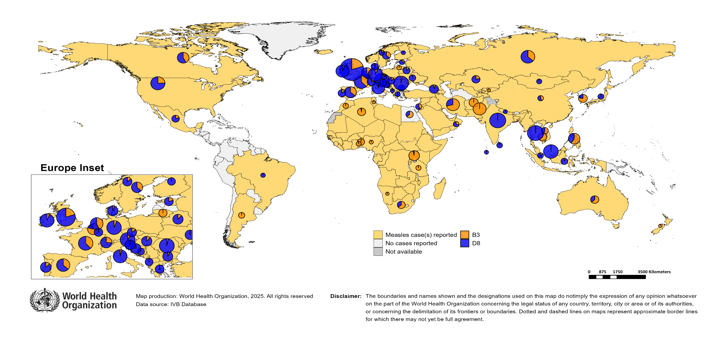
Distribution of measles genotypes (last 12 months)
Data Source: MeaNS2 database (Genotypes) and IVB Database (Incidence) as of 2025-04-10 and covering the period between 2024-03 and 2025-02 - Pie charts proportional to the number of sequenced viruses

Slide 40
Rubella

Slide 41
Number of reported rubella cases by WHO Region
2025
Region | Member States* | Rubella cases | Clin | Epi | Lab | Date Received
AFR | 35/47 | 817 | 0 | 0 | 817 | 2025-04
AMR | 20/35 | 0 | 0 | 0 | 0 | 2025-04
EMR | 19/21 | 132 | 33 | 3 | 96 | 2025-04
EUR | 27/53 | 104 | 11 | 4 | 89 | 2025-04
SEAR | 11/11 | 581 | 0 | 14 | 567 | 2025-04
WPR | 13/27 | 96 | 20 | 0 | 76 | 2025-04
Total | 125/194 | 1,730 | 64 | 21 | 1,645
Region | Jan | Feb | Mar | Apr | May | Jun | Jul | Aug | Sep | Oct | Nov | Dec
AFR | 345 | 279 | 193 | 0 | 0 | 0 | 0 | 0 | 0 | 0 | 0 | 0
AMR | 0 | 0 | 0 | 0 | 0 | 0 | 0 | 0 | 0 | 0 | 0 | 0
EMR | 81 | 36 | 15 | 0 | 0 | 0 | 0 | 0 | 0 | 0 | 0 | 0
EUR | 71 | 29 | 4 | 0 | 0 | 0 | 0 | 0 | 0 | 0 | 0 | 0
SEAR | 285 | 248 | 48 | 0 | 0 | 0 | 0 | 0 | 0 | 0 | 0 | 0
WPR | 46 | 50 | 0 | 0 | 0 | 0 | 0 | 0 | 0 | 0 | 0 | 0
Total | 828 | 642 | 260 | 0 | 0 | 0 | 0 | 0 | 0 | 0 | 0 | 0
2024
Region | Member States* | Rubella cases | Clin | Epi | Lab | Date Received
AFR | 43/47 | 15,738 | 0 | 0 | 15,738 | 2025-04
AMR | 28/35 | 0 | 0 | 0 | 0 | 2025-04
EMR | 20/21 | 3,473 | 2,516 | 188 | 769 | 2025-04
EUR | 33/53 | 510 | 212 | 2 | 296 | 2025-04
SEAR | 11/11 | 3,178 | 0 | 106 | 3,072 | 2025-04
WPR | 16/27 | 658 | 81 | 0 | 577 | 2025-04
Total | 151/194 | 23,557 | 2,809 | 296 | 20,452
Region | Jan | Feb | Mar | Apr | May | Jun | Jul | Aug | Sep | Oct | Nov | Dec
AFR | 357 | 345 | 645 | 567 | 832 | 574 | 396 | 1,897 | 4,278 | 3,063 | 1,880 | 904
AMR | 0 | 0 | 0 | 0 | 0 | 0 | 0 | 0 | 0 | 0 | 0 | 0
EMR | 335 | 360 | 362 | 287 | 350 | 284 | 234 | 262 | 376 | 358 | 188 | 77
EUR | 25 | 39 | 49 | 67 | 78 | 52 | 43 | 50 | 31 | 25 | 28 | 23
SEAR | 278 | 310 | 322 | 268 | 265 | 222 | 256 | 217 | 246 | 295 | 274 | 225
WPR | 44 | 34 | 75 | 69 | 63 | 43 | 47 | 64 | 45 | 69 | 50 | 55
Total | 1,039 | 1,088 | 1,453 | 1,258 | 1,588 | 1,175 | 976 | 2,490 | 4,976 | 3,810 | 2,420 | 1,284
Notes: Based on data received 2025-04 - This is surveillance data, hence for the last month, the data may be incomplete. * Member States Reporting / Total Member States in Region

Slide 42
Rubella case distribution by month and WHO Region (2017-2025)
2017
2018
2019
2020
2021
2022
2023
2024
2025
10,712 cases
17,045 cases
47,766 cases
7,501 cases
7,410 cases
12,620 cases
10,684 cases
23,557 cases
1,730 cases
9,000
AFR
AMR
6,000
EMR
EUR
SEAR
WPR
3,000
0
May
Sep
Sep
Sep
Sep
Sep
Sep
Sep
Sep
Sep
Apr
Aug
May
Aug
May
Aug
May
Aug
May
Aug
May
Aug
May
Aug
May
Aug
May
Aug
Jan
Jun
Jul
Oct
Jan
Apr
Jun
Jul
Oct
Jan
Apr
Jun
Jul
Oct
Jan
Apr
Jun
Jul
Oct
Jan
Apr
Jun
Jul
Oct
Jan
Apr
Jun
Jul
Oct
Jan
Apr
Jun
Jul
Oct
Jan
Apr
Jun
Jul
Oct
Jan
Apr
Jun
Jul
Oct
Feb
Mar
Nov
Dec
Feb
Mar
Nov
Dec
Feb
Mar
Nov
Dec
Feb
Mar
Nov
Dec
Feb
Mar
Nov
Dec
Feb
Mar
Nov
Dec
Feb
Mar
Nov
Dec
Feb
Mar
Nov
Dec
Feb
Mar
Nov
Dec
Based on data received 2025-04 - Data Source: IVB Database - This is surveillance data, hence for the last month(s), the data may be incomplete.

Slide 43
Rubella case distribution by month and WHO Region (2023-2025)
2023
2024
2025
10,684 cases
23,557 cases
1,730 cases
5,000
4,000
AFR
3,000
EMR
EUR
SEAR
2,000
WPR
1,000
0
Jan
Feb
Mar
Apr
May
Jun
Jul
Aug
Sep
Oct
Nov
Dec
Jan
Feb
Mar
Apr
May
Jun
Jul
Aug
Sep
Oct
Nov
Dec
Jan
Feb
Mar
Apr
May
Jun
Jul
Aug
Sep
Oct
Nov
Dec
Based on data received 2025-04 - Data Source: IVB Database - This is surveillance data, hence for the last month(s), the data may be incomplete.

Slide 44
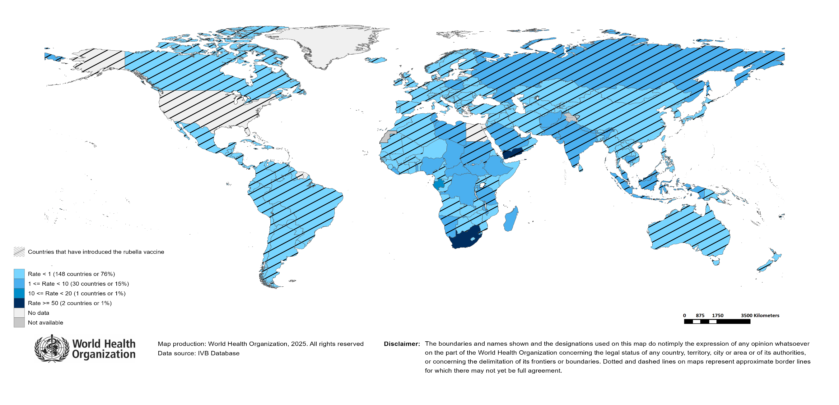
Rubella Incidence Rate per Million (12M period)
Highest incidence rates | Highest incidence rates | Highest incidence rates
Country | Cases | Rate
South Africa | 13535 | 211.46
Yemen | 2190 | 53.96
Gabon | 40 | 15.75
Chad | 149 | 7.34
Togo | 46 | 4.83
United Republic of Tanzania | 301 | 4.39
Poland | 164 | 4.26
Madagascar | 108 | 3.38
Libya | 24 | 3.25
Eswatini | 4 | 3.22
Notes: Based on data received 2025-04 - Surveillance data from 2024-09 to 2025-02 - Incidence: Number of cases / population * 1,000,000 - Population data: World population prospects, 2019 revision

Slide 45
Disclaimer
This document contains data provided to WHO by member states. Note that some member states only provide aggregate data to WHO, and for these, we are unable to generate a country profile. Some member states report all cases at one time point for the entire year, and thus epidemiologic curves generated are not accurate and a reporting artifact. For some countries, cases are reported by age category, not by exact age in months and/or years. Thus, age distribution/incidence is approximate. Cases classified as pending by countries are classified at WHO as clinically compatible at this time, and thus numbers might different between data shown here and provided by the member state or WHO country/regional offices.
*UN population data is used as the denominator for calculating incidence.

Slide 46
Rubella cases (AFR)
AFR Rubella Case Distribution (January 2023-April 2025)
Top 10 countries (last 12 M) | Top 10 countries (last 12 M) | Top 10 countries (last 12 M) | Top 10 countries (last 12 M)
Country | RCV in RI | Cases | % of Total
South Africa | No | 13333 | 88
Nigeria | No | 393 | 3
United Republic of Tanzania | 2014 | 278 | 2
Ethiopia | No | 257 | 2
Others | - | 250 | 2
DR Congo | No | 243 | 2
Chad | No | 142 | 1
Togo | 2018 | 123 | 1
Madagascar | No | 101 | 1
Malawi | 2017 | 45 | 0
Uganda | 2019 | 43 | 0
2023
2024
2025
4,000
3,000
(lab + epi-linked + clinical)
Number of cases
2,000
1,000
0
Jan
Feb
Mar
Apr
May
Jun
Jul
Aug
Sep
Oct
Nov
Dec
Jan
Feb
Mar
Apr
May
Jun
Jul
Aug
Sep
Oct
Nov
Dec
Jan
Feb
Mar
Apr
May
Jun
Jul
Aug
Sep
Oct
Nov
Dec
Introduced less than 5 years ago
Introduced more than 5 years ago
Not introduced in EPI
(after 2020)
(2020 and before)
AFR Age distribution of Rubella IgM+ cases by vaccine introduction status in the National EPI Programme (last 12 Months)
2000
1500
1000
(IgM+ only)
Number of cases
500
0
0
10
20
30
40
Age at onset (in years)
Rubella vaccine introduced before 1 January 2025
Rubella vaccine not introduced before 1 January 2025
Notes: Based on data received 2025-04 Data Source: IVB Database.

Slide 47
Rubella cases: Democratic Republic of the Congo
ELIMINATION STATUS:
ENDEMIC
2022
2023
2024
2025
Total = 1,237 cases
Total = 594 cases
Total = 300 cases
Total = 25 cases
200
Rubella cases
100
0
Jan
Feb
Mar
Apr
May
Jun
Jul
Aug
Sep
Oct
Nov
Dec
Jan
Feb
Mar
Apr
May
Jun
Jul
Aug
Sep
Oct
Nov
Dec
Jan
Feb
Mar
Apr
May
Jun
Jul
Aug
Sep
Oct
Nov
Dec
Jan
Feb
Mar
Apr
May
Jun
Jul
Aug
Sep
Oct
Nov
Dec
Clinical
Epi
Lab
Age distribution, sex and incidence (Last 12 months)
WHO/UNICEF Coverage Estimates (WUENIC)
100
8
100
75
6
80
4
Number of cases
Incidence rate per M
60
50
% Coverage
25
2
40
0
0
20
<1 yr
1-4 yrs
5-9 yrs
10-14 yrs
15-24 yrs
25-39 yrs
40+ yrs
0
Age at onset (in years)
2000
2001
2002
2003
2004
2005
2006
2007
2008
2009
2010
2011
2012
2013
2014
2015
2016
2017
2018
2019
2020
2021
2022
2023
Incidence
Male
Female
Unknown
RCV1

Slide 48
Rubella cases: Ethiopia
ELIMINATION STATUS:
ENDEMIC
300
2022
2023
2024
2025
Total = 698 cases
Total = 930 cases
Total = 242 cases
Total = 134 cases
200
Rubella cases
100
0
Jan
Feb
Mar
Apr
May
Jun
Jul
Aug
Sep
Oct
Nov
Dec
Jan
Feb
Mar
Apr
May
Jun
Jul
Aug
Sep
Oct
Nov
Dec
Jan
Feb
Mar
Apr
May
Jun
Jul
Aug
Sep
Oct
Nov
Dec
Jan
Feb
Mar
Apr
May
Jun
Jul
Aug
Sep
Oct
Nov
Dec
Clinical
Epi
Lab
Age distribution, sex and incidence (Last 12 months)
WHO/UNICEF Coverage Estimates (WUENIC)
100
100
7.5
80
5.0
Number of cases
Incidence rate per M
60
50
% Coverage
2.5
40
0
0.0
20
<1 yr
1-4 yrs
5-9 yrs
10-14 yrs
15-24 yrs
25-39 yrs
40+ yrs
0
Age at onset (in years)
2000
2001
2002
2003
2004
2005
2006
2007
2008
2009
2010
2011
2012
2013
2014
2015
2016
2017
2018
2019
2020
2021
2022
2023
Incidence
Male
Female
Unknown
RCV1

Slide 49
Rubella cases: Nigeria
ELIMINATION STATUS:
ENDEMIC
2022
2023
2024
2025
300
Total = 895 cases
Total = 740 cases
Total = 651 cases
Total = 99 cases
200
Rubella cases
100
0
Jan
Feb
Mar
Apr
May
Jun
Jul
Aug
Sep
Oct
Nov
Dec
Jan
Feb
Mar
Apr
May
Jun
Jul
Aug
Sep
Oct
Nov
Dec
Jan
Feb
Mar
Apr
May
Jun
Jul
Aug
Sep
Oct
Nov
Dec
Jan
Feb
Mar
Apr
May
Jun
Jul
Aug
Sep
Oct
Nov
Dec
Clinical
Epi
Lab
Age distribution, sex and incidence (Last 12 months)
WHO/UNICEF Coverage Estimates (WUENIC)
8
100
150
6
80
100
4
Number of cases
Incidence rate per M
60
50
% Coverage
2
40
0
0
20
<1 yr
1-4 yrs
5-9 yrs
10-14 yrs
15-24 yrs
25-39 yrs
40+ yrs
0
Age at onset (in years)
2000
2001
2002
2003
2004
2005
2006
2007
2008
2009
2010
2011
2012
2013
2014
2015
2016
2017
2018
2019
2020
2021
2022
2023
Incidence
Male
Female
Unknown
RCV1

Slide 50
Rubella cases (EMR)
EMR Rubella Case Distribution (January 2023-April 2025)
Top 10 countries (last 12 M) | Top 10 countries (last 12 M) | Top 10 countries (last 12 M) | Top 10 countries (last 12 M)
Country | RCV in RI | Cases | % of Total
Yemen | 2015 | 1933 | 76
Pakistan | 2022 | 244 | 10
Afghanistan | No | 111 | 4
Saudi Arabia | 1982 | 74 | 3
Sudan | 2024 | 53 | 2
Others | - | 34 | 1
Tunisia | 2012 | 28 | 1
Libya | 1993 | 22 | 1
Iran (Islamic Republic of) | 2004 | 21 | 1
Morocco | 2003 | 16 | 1
United Arab Emirates | 1985 | 12 | 0
2023
2024
2025
300
200
(lab + epi-linked + clinical)
Number of cases
100
0
Jan
Feb
Mar
Apr
May
Jun
Jul
Aug
Sep
Oct
Nov
Dec
Jan
Feb
Mar
Apr
May
Jun
Jul
Aug
Sep
Oct
Nov
Dec
Jan
Feb
Mar
Apr
May
Jun
Jul
Aug
Sep
Oct
Nov
Dec
Introduced less than 5 years ago
Introduced more than 5 years ago
Not introduced in EPI
(after 2020)
(2020 and before)
EMR Age distribution of Rubella IgM+ cases by vaccine introduction status in the National EPI Programme (last 12 Months)
500
400
300
(IgM+ only)
Number of cases
200
100
0
0
10
20
30
40
Age at onset (in years)
Rubella vaccine introduced before 1 January 2025
Rubella vaccine not introduced before 1 January 2025
Notes: Based on data received 2025-04 Data Source: IVB Database.

Slide 51
Rubella cases: Afghanistan
ELIMINATION STATUS:
ENDEMIC
2022
2023
2024
2025
50
Total = 197 cases
Total = 229 cases
Total = 152 cases
Total = 34 cases
40
30
Rubella cases
20
10
0
Jan
Feb
Mar
Apr
May
Jun
Jul
Aug
Sep
Oct
Nov
Dec
Jan
Feb
Mar
Apr
May
Jun
Jul
Aug
Sep
Oct
Nov
Dec
Jan
Feb
Mar
Apr
May
Jun
Jul
Aug
Sep
Oct
Nov
Dec
Jan
Feb
Mar
Apr
May
Jun
Jul
Aug
Sep
Oct
Nov
Dec
Clinical
Epi
Lab
Age distribution, sex and incidence (Last 12 months)
WHO/UNICEF Coverage Estimates (WUENIC)
100
15
80
40
10
Number of cases
Incidence rate per M
60
20
5
% Coverage
40
0
0
20
<1 yr
1-4 yrs
5-9 yrs
10-14 yrs
15-24 yrs
25-39 yrs
40+ yrs
0
Age at onset (in years)
2000
2001
2002
2003
2004
2005
2006
2007
2008
2009
2010
2011
2012
2013
2014
2015
2016
2017
2018
2019
2020
2021
2022
2023
Incidence
Male
Female
Unknown
RCV1

Slide 52
Rubella cases (EUR)
EUR Rubella Case Distribution (January 2023-April 2025)
Top 10 countries (last 12 M) | Top 10 countries (last 12 M) | Top 10 countries (last 12 M) | Top 10 countries (last 12 M)
Country | RCV in RI | Cases | % of Total
Russian Federation | 2000 | 313 | 62
Poland | 1988 | 130 | 26
Germany | 1991 | 15 | 3
Türkiye | 2006 | 14 | 3
Ukraine | 2003 | 11 | 2
Others | - | 5 | 1
Kyrgyzstan | 2001 | 4 | 1
Sweden | 1982 | 4 | 1
Italy | 1972 | 2 | 0
Uzbekistan | 2006 | 2 | 0
Bulgaria | 1992 | 1 | 0
2023
2024
2025
80
60
(lab + epi-linked + clinical)
Number of cases
40
20
0
Jan
Feb
Mar
Apr
May
Jun
Jul
Aug
Sep
Oct
Nov
Dec
Jan
Feb
Mar
Apr
May
Jun
Jul
Aug
Sep
Oct
Nov
Dec
Jan
Feb
Mar
Apr
May
Jun
Jul
Aug
Sep
Oct
Nov
Dec
Introduced more than 5 years ago
(2020 and before)
EUR Age distribution of Rubella IgM+ cases by vaccine introduction status in the National EPI Programme (last 12 Months)
15
10
(IgM+ only)
Number of cases
5
0
0
10
20
30
40
Age at onset (in years)
Rubella vaccine introduced before 1 January 2025
Rubella vaccine not introduced before 1 January 2025
Notes: Based on data received 2025-04 Data Source: IVB Database. Spikes in age-distribution curve are an artifact of reporting by age bands ( 0=<1 yrs, 2=1-4 yrs, 7=5-9 yrs, 12=10-14 yrs, 17=15-19 yrs, 25=20-29 yrs, 45=30+yrs) instead of by age from some member states.

Slide 53
Rubella cases (SEAR (excl. India))
SEAR (excl. India) Rubella Case Distribution (January 2023-April 2025)
Top 10 countries (last 12 M) | Top 10 countries (last 12 M) | Top 10 countries (last 12 M) | Top 10 countries (last 12 M)
Country | RCV in RI | Cases | % of Total
Indonesia | 2018 | 355 | 66
Bangladesh | 2012 | 90 | 17
Nepal | 2013 | 60 | 11
Thailand | 1997 | 27 | 5
Myanmar | 2015 | 4 | 1
Timor-Leste | 2016 | 1 | 0
2023
2024
2025
125
100
75
(lab + epi-linked + clinical)
Number of cases
50
25
0
Jan
Feb
Mar
Apr
May
Jun
Jul
Aug
Sep
Oct
Nov
Dec
Jan
Feb
Mar
Apr
May
Jun
Jul
Aug
Sep
Oct
Nov
Dec
Jan
Feb
Mar
Apr
May
Jun
Jul
Aug
Sep
Oct
Nov
Dec
Introduced more than 5 years ago
(2020 and before)
SEAR (excl. India) Age distribution of Rubella IgM+ cases by vaccine introduction status in the National EPI Programme (last 12 Months)
75
50
(IgM+ only)
Number of cases
25
0
0
10
20
30
40
Age at onset (in years)
Rubella vaccine introduced before 1 January 2025
Rubella vaccine not introduced before 1 January 2025
Notes: Based on data received 2025-04 Data Source: IVB Database.

Slide 54
Rubella cases: Indonesia
ELIMINATION STATUS:
ENDEMIC
2022
2023
2024
2025
150
Total = 755 cases
Total = 477 cases
Total = 457 cases
Total = 29 cases
100
Rubella cases
50
0
Jan
Feb
Mar
Apr
May
Jun
Jul
Aug
Sep
Oct
Nov
Dec
Jan
Feb
Mar
Apr
May
Jun
Jul
Aug
Sep
Oct
Nov
Dec
Jan
Feb
Mar
Apr
May
Jun
Jul
Aug
Sep
Oct
Nov
Dec
Jan
Feb
Mar
Apr
May
Jun
Jul
Aug
Sep
Oct
Nov
Dec
Clinical
Epi
Lab
Age distribution, sex and incidence (Last 12 months)
WHO/UNICEF Coverage Estimates (WUENIC)
1.00
0.20
100
0.75
0.15
80
0.50
Incidence rate per M
60
Number of cases
0.10
% Coverage
0.25
0.05
40
0.00
0.00
20
<1 yr
1-4 yrs
5-9 yrs
10-14 yrs
15-24 yrs
25-39 yrs
40+ yrs
0
Age at onset (in years)
2000
2001
2002
2003
2004
2005
2006
2007
2008
2009
2010
2011
2012
2013
2014
2015
2016
2017
2018
2019
2020
2021
2022
2023
Incidence
Male
Female
Unknown
RCV1

Slide 55
Rubella cases (SEAR, India)
SEAR, India Rubella Case Distribution (January 2023-April 2025)
Top 10 countries (last 12 M) | Top 10 countries (last 12 M) | Top 10 countries (last 12 M) | Top 10 countries (last 12 M)
Country | RCV in RI | Cases | % of Total
India | 2018 | 2312 | 100
2023
2024
2025
300
200
(lab + epi-linked + clinical)
Number of cases
100
0
Jan
Feb
Mar
Apr
May
Jun
Jul
Aug
Sep
Oct
Nov
Dec
Jan
Feb
Mar
Apr
May
Jun
Jul
Aug
Sep
Oct
Nov
Dec
Jan
Feb
Mar
Apr
May
Jun
Jul
Aug
Sep
Oct
Nov
Dec
Introduced more than 5 years ago
(2020 and before)
SEAR, India Age distribution of Rubella IgM+ cases by vaccine introduction status in the National EPI Programme (last 12 Months)
600
400
(IgM+ only)
Number of cases
200
0
0
10
20
30
40
Age at onset (in years)
Rubella vaccine introduced before 1 January 2025
Rubella vaccine not introduced before 1 January 2025
Notes: Based on data received 2025-04 Data Source: IVB Database.

Slide 56
Rubella cases: India
ELIMINATION STATUS:
ENDEMIC
2022
2023
2024
2025
500
Total = 2,559 cases
Total = 2,930 cases
Total = 2,523 cases
Total = 527 cases
400
300
Rubella cases
200
100
0
Jan
Feb
Mar
Apr
May
Jun
Jul
Aug
Sep
Oct
Nov
Dec
Jan
Feb
Mar
Apr
May
Jun
Jul
Aug
Sep
Oct
Nov
Dec
Jan
Feb
Mar
Apr
May
Jun
Jul
Aug
Sep
Oct
Nov
Dec
Jan
Feb
Mar
Apr
May
Jun
Jul
Aug
Sep
Oct
Nov
Dec
Clinical
Epi
Lab
Age distribution, sex and incidence (Last 12 months)
WHO/UNICEF Coverage Estimates (WUENIC)
30
100
750
20
80
500
Incidence rate per M
60
Number of cases
250
10
% Coverage
40
0
0
20
<1 yr
1-4 yrs
5-9 yrs
10-14 yrs
15-24 yrs
25-39 yrs
40+ yrs
0
Age at onset (in years)
2000
2001
2002
2003
2004
2005
2006
2007
2008
2009
2010
2011
2012
2013
2014
2015
2016
2017
2018
2019
2020
2021
2022
2023
Incidence
Male
Female
Unknown
RCV1

Slide 57
Rubella cases (WPR)
WPR Rubella Case Distribution (January 2023-April 2025)
Top 10 countries (last 12 M) | Top 10 countries (last 12 M) | Top 10 countries (last 12 M) | Top 10 countries (last 12 M)
Country | RCV in RI | Cases | % of Total
China | 2008 | 405 | 67
Malaysia | 2004 | 72 | 12
Philippines | 2010 | 51 | 8
Cambodia | 2013 | 39 | 6
Viet Nam | 2015 | 26 | 4
Japan | 1995 | 7 | 1
Singapore | 1982 | 1 | 0
2023
2024
2025
75
50
(lab + epi-linked + clinical)
Number of cases
25
0
Jan
Feb
Mar
Apr
May
Jun
Jul
Aug
Sep
Oct
Nov
Dec
Jan
Feb
Mar
Apr
May
Jun
Jul
Aug
Sep
Oct
Nov
Dec
Jan
Feb
Mar
Apr
May
Jun
Jul
Aug
Sep
Oct
Nov
Dec
Introduced more than 5 years ago
(2020 and before)
WPR Age distribution of Rubella IgM+ cases by vaccine introduction status in the National EPI Programme (last 12 Months)
100
75
50
(IgM+ only)
Number of cases
25
0
0
10
20
30
40
Age at onset (in years)
Rubella vaccine introduced before 1 January 2025
Rubella vaccine not introduced before 1 January 2025
Notes: Based on data received 2025-04 Data Source: IVB Database.

Slide 58
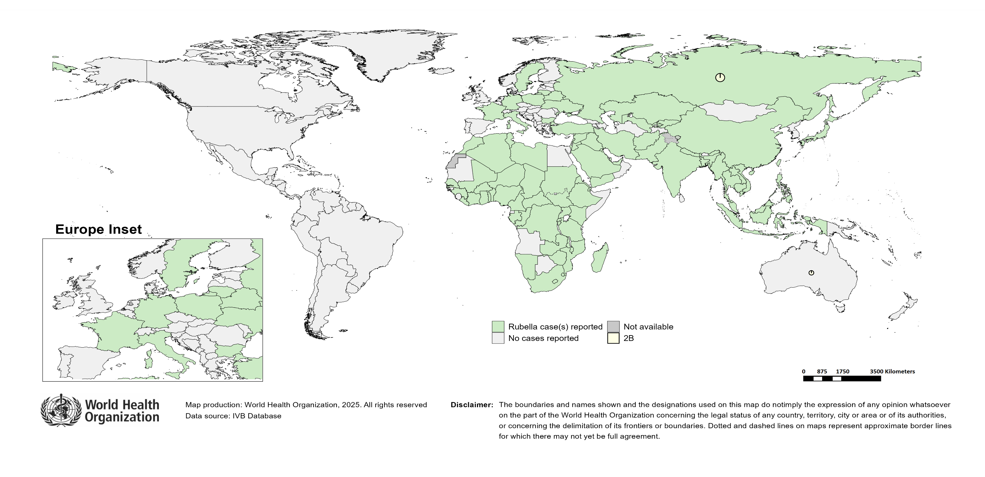
Distribution of rubella genotypes (last 12 months)
Data Source: RUBENS2 database (Genotypes) and IVB Database (Incidence) as of 2025-04-10 and covering the period between 2024-03 and 2025-02 - Pie charts proportional to the number of sequenced viruses

Slide 59
Laboratory

Slide 60
Measles and Rubella IgM Data Summary
2025
Region | Member States* | Specimens received | Measles tested | Measles positive n(%) | Measles equivocal n(%) | Measles negative n(%) | Rubella tested | Rubella positive n(%) | Rubella equivocal n(%) | Rubella negative n(%)
AFR | 25/47 | 7,792 | 7,565 | 1,272 (17) | 79 (1) | 4,318 (57) | 6,525 | 561 (9) | 89 (1) | 3,971 (61)
AMR | 20/35 | 1,155 | 1,201 | 109 (9) | 29 (2) | 1,063 (89) | 1,171 | 48 (4) | 19 (2) | 1,104 (94)
EMR | 19/21 | 16,008 | 12,596 | 6,555 (52) | 4 (0) | 6,037 (48) | 8,863 | 298 (3) | 6 (0) | 8,559 (97)
EUR | 33/53 | 7,463 | 6,352 | 2,584 (41) | 54 (1) | 3,721 (59) | 2,348 | 90 (4) | 28 (1) | 2,024 (86)
SEAR | 10/11 | 17,763 | 15,802 | 2,180 (14) | 176 (1) | 13,447 (85) | 14,701 | 480 (3) | 129 (1) | 14,092 (96)
WPR | 25/27 | 3,600 | 3,536 | 1,103 (31) | 49 (1) | 2,379 (67) | 2,795 | 71 (3) | 19 (1) | 2,705 (97)
Total | 132/194 | 53,781 | 47,052 | 13,803 (29) | 391 (1) | 30,965 (66) | 36,403 | 1,548 (4) | 290 (1) | 32,455 (89)
2024
Region | Member States* | Specimens received | Measles tested | Measles positive n(%) | Measles equivocal n(%) | Measles negative n(%) | Rubella tested | Rubella positive n(%) | Rubella equivocal n(%) | Rubella negative n(%)
AFR | 43/47 | 120,445 | 109,377 | 19,102 (17) | 1,068 (1) | 61,018 (56) | 95,315 | 14,882 (16) | 465 (0) | 51,744 (54)
AMR | 29/35 | 8,171 | 8,306 | 378 (5) | 217 (3) | 7,711 (93) | 7,731 | 185 (2) | 105 (1) | 7,441 (96)
EMR | 20/21 | 113,653 | 95,258 | 38,161 (40) | 126 (0) | 56,971 (60) | 87,045 | 1,407 (2) | 76 (0) | 85,562 (98)
EUR | 44/53 | 159,431 | 137,247 | 78,285 (57) | 404 (0) | 53,523 (39) | 56,088 | 1,305 (2) | 363 (1) | 54,160 (97)
SEAR | 11/11 | 129,727 | 127,549 | 18,898 (15) | 3,678 (3) | 108,724 (85) | 117,938 | 3,087 (3) | 3,040 (3) | 114,106 (97)
WPR | 25/27 | 23,799 | 22,032 | 5,695 (26) | 505 (2) | 15,807 (72) | 17,280 | 601 (3) | 88 (1) | 16,560 (96)
Total | 172/194 | 555,226 | 499,769 | 160,519 (32) | 5,998 (1) | 303,754 (61) | 381,397 | 21,467 (6) | 4,137 (1) | 329,573 (86)
Notes: Based on data received 2025-04 - * Member States Reporting / Total Member States in Region

Slide 61
Supplementary Immunization Activities

Slide 62
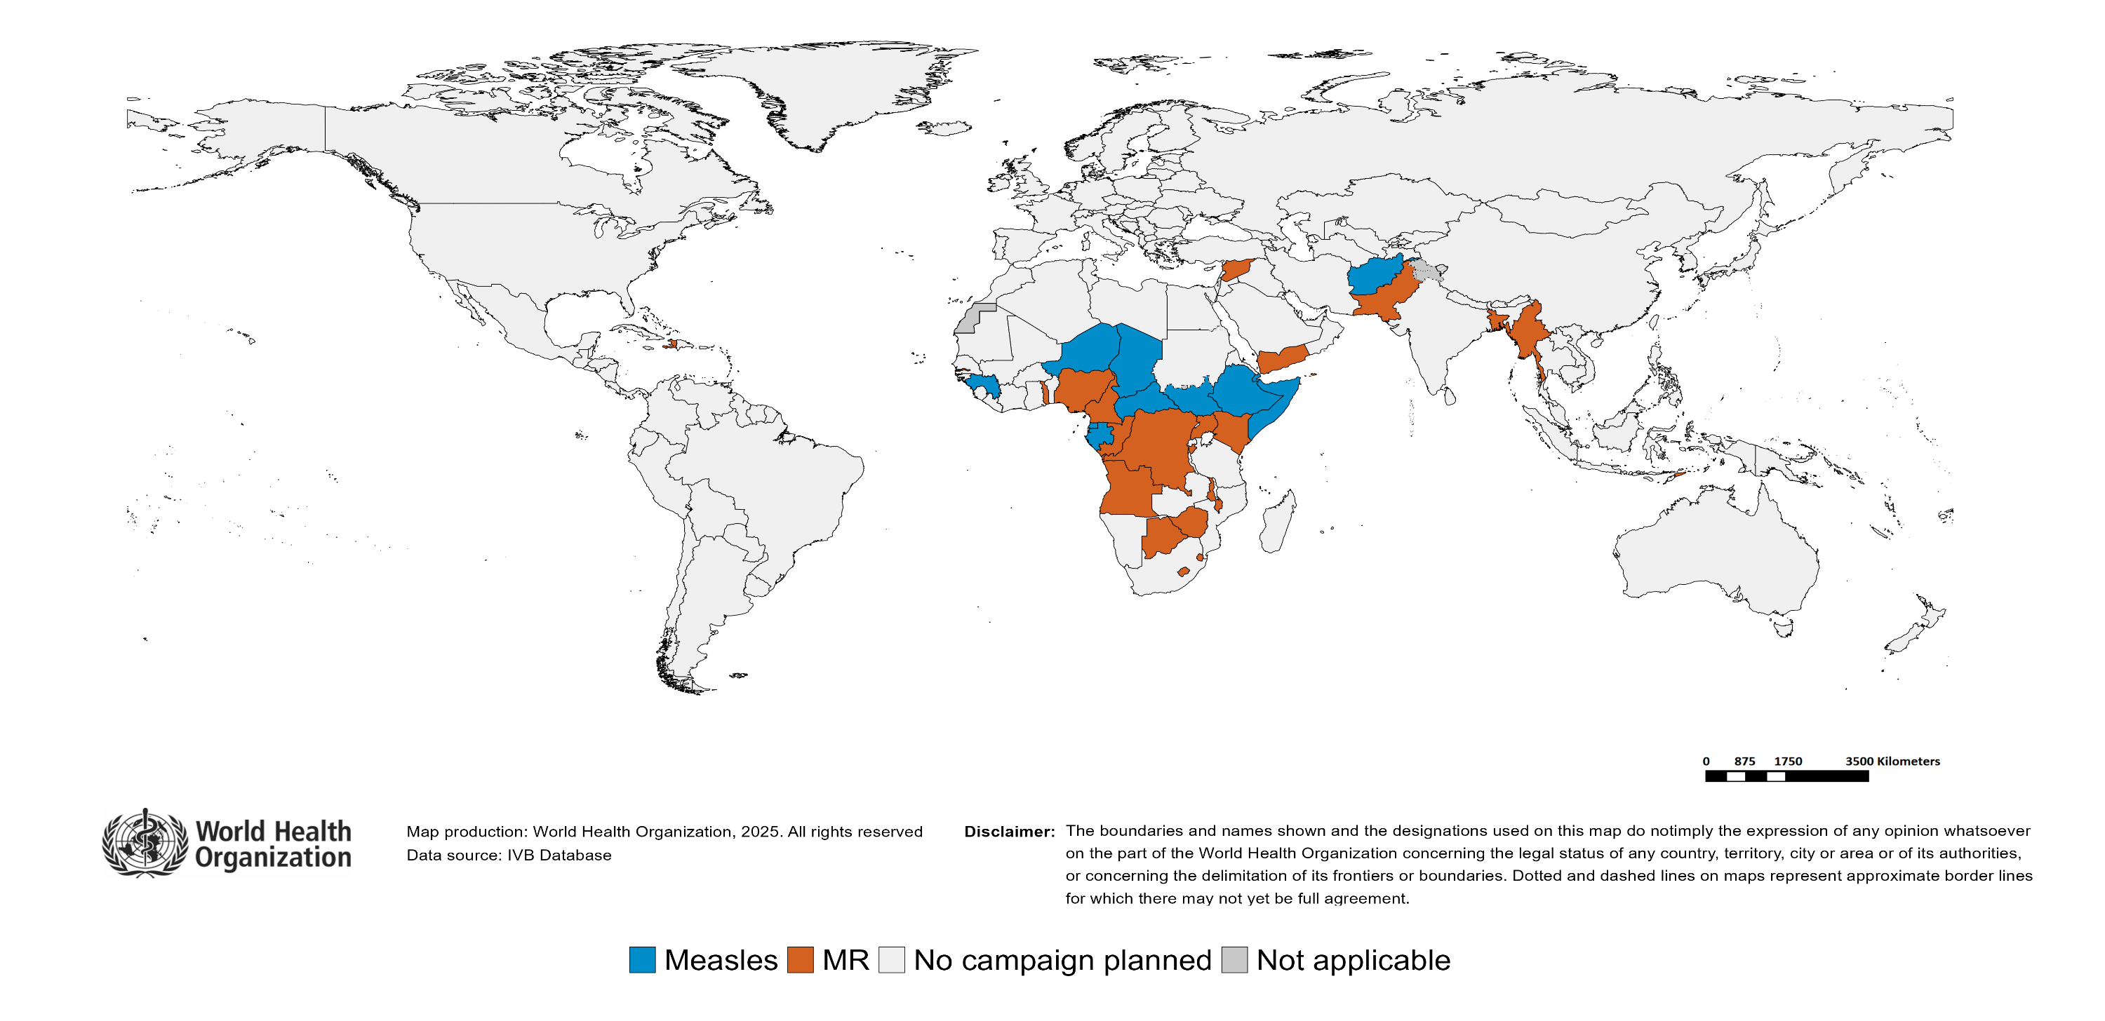
Upcoming MMR, MR and Measles campaigns (2025-2026)

Slide 63
Upcoming MMR, MR and Measles campaigns (2025-2026)
Year | Region | Name | Type | Intervention | StartDate | Status | Age Group(s) | Extent | Target
2025 | AFR | Gabon | PIRI | MEASLES | 2025-02-?? | Planned | 9-59 M | - | 146061
2025 | AFR | Guinea | FollowUp | MEASLES | 2025-03-?? | Planned | 9-59 M | NATIONAL | 996214
2025 | AFR | Equatorial Guinea | FollowUp | MEASLES | 2025-04-?? | Planned | 9 M-10 Y | NATIONAL | 178156
2025 | AFR | Niger | FollowUp | MEASLES | 2025-04-?? | Planned | 9-59 M | NATIONAL | 4972177
2025 | AFR | South Sudan | FollowUp | MEASLES | 2025-04-24 | Planned | 9-59 M | NATIONAL | 1485839
2025 | AFR | Ethiopia | FollowUp | MEASLES | 2025-05-07 | Planned | 9-59 M | NATIONAL | 17520779
2025 | AFR | Congo | FollowUp | MR | 2025-08-?? | Planned | 9-59 M | NATIONAL | 846894
2025 | AFR | Central African Republic | FollowUp | MEASLES | 2025-10-?? | Planned | 6-59 M | NATIONAL | 1335862
2025 | AFR | Democratic Republic of the Congo | CatchUp | MR | 2025-10-?? | Planned | 9 M-14 Y | NATIONAL | 61697195
2025 | AFR | Nigeria | CatchUp | MR | 2025-10-?? | Planned | 9 M-14 Y | NATIONAL | 97224670
2025 | AFR | Lesotho | CatchUp-SIA | MR | 2025-10-22 | Planned | 9-59 M | NATIONAL | 274805
2025 | AFR | Uganda | FollowUp | MR | 2025-11-?? | Planned | 9-59 M | NATIONAL | 7685529
2025 | AFR | Comoros | FollowUp | MR | 2025-12-?? | Planned | 9-59 M | NATIONAL | 113688
2025 | AFR | Togo | FollowUp | MR | 2025-12-?? | Planned | 9 M-9 Y | NATIONAL | 2219710
2025 | AFR | Botswana | FollowUp | MR | 2025-NA-?? | Planned | 9-59 M | NATIONAL | 148268
2025 | AFR | Chad | FollowUp | MEASLES | 2025-NA-?? | Planned | 9-59 M | NATIONAL | 3217682
2025 | AFR | Chad | Follow-Up | MEASLES | 2025-NA-?? | Planned | 9-59 M | NATIONAL | 4972177
2025 | AFR | Eswatini | FollowUp | MR | 2025-NA-?? | Planned | 9-59 M | NATIONAL | 140066
2025 | AFR | Gambia | FollowUp | MR | 2025-NA-?? | Planned | 9-59 M | NATIONAL | 412351
2025 | AFR | Kenya | FollowUp | MR | 2025-NA-?? | Planned | 9-59 M | NATIONAL | 6913106
2025 | AFR | Zimbabwe | FollowUp | MR | 2025-NA-?? | Planned | 9-59 M | NATIONAL | 2299711
2025 | AMR | Haiti | Campaign | MR | 2025-11-?? | Planned | - | - | -
2025 | AMR | Saint Kitts and Nevis | Vaccination Week | MR_MMR | 2025-NA-?? | Planned | 12-59 M | NATIONAL | -
2025 | EMR | Pakistan | FollowUp | MR | 2025-10-?? | Planned | 9-59 M | NATIONAL | 29604478
2025 | EMR | Afghanistan | FollowUp | MEASLES | 2025-11-?? | Planned | 9-59 M | NATIONAL | 16047992
2025 | EMR | Somalia | FollowUp | MEASLES | 2025-NA-?? | Planned | 9-59 M | NATIONAL | 3200130
2025 | SEAR | Bangladesh | FollowUp | MR | 2025-09-?? | Planned | 9-59 M | NATIONAL | 14663335
2026 | AFR | Malawi | FollowUp | MR | 2026-04-?? | Planned | 9-59 M | NATIONAL | 3034104
2026 | AFR | Angola | FollowUp | MR | 2026-NA-?? | Planned | 9-59 M | NATIONAL | 5983408
2026 | AFR | Burundi | FollowUp | MR | 2026-NA-?? | Planned | 9-59 M | NATIONAL | 2053824
2026 | AFR | Cameroon | FollowUp | MR | 2026-NA-?? | Planned | 9-59 M | NATIONAL | 4345819
2026 | AFR | Equatorial Guinea | FollowUp | MEASLES | 2026-NA-?? | Planned | 9-59 M | NATIONAL | 229691
2026 | EMR | Djibouti | CatchUp | MEASLES | 2026-NA-?? | Planned | 9-59 M | NATIONAL | 340185
2026 | EMR | Syrian Arab Republic | FollowUp | MR | 2026-NA-?? | Planned | 9-59 M | NATIONAL | 1892447
2026 | EMR | Yemen | FollowUp | MR | 2026-NA-?? | Planned | 9-59 M | NATIONAL | 4714060
2026 | SEAR | Myanmar | FollowUp | MR | 2026-NA-?? | Planned | 9-59 M | NATIONAL | 4491396
2026 | SEAR | Timor-Leste | FollowUp | MR | 2026-NA-?? | Planned | 9-59 M | NATIONAL | 157311

Slide 64
WHO Bulletins and Newsletters

